Slide 1
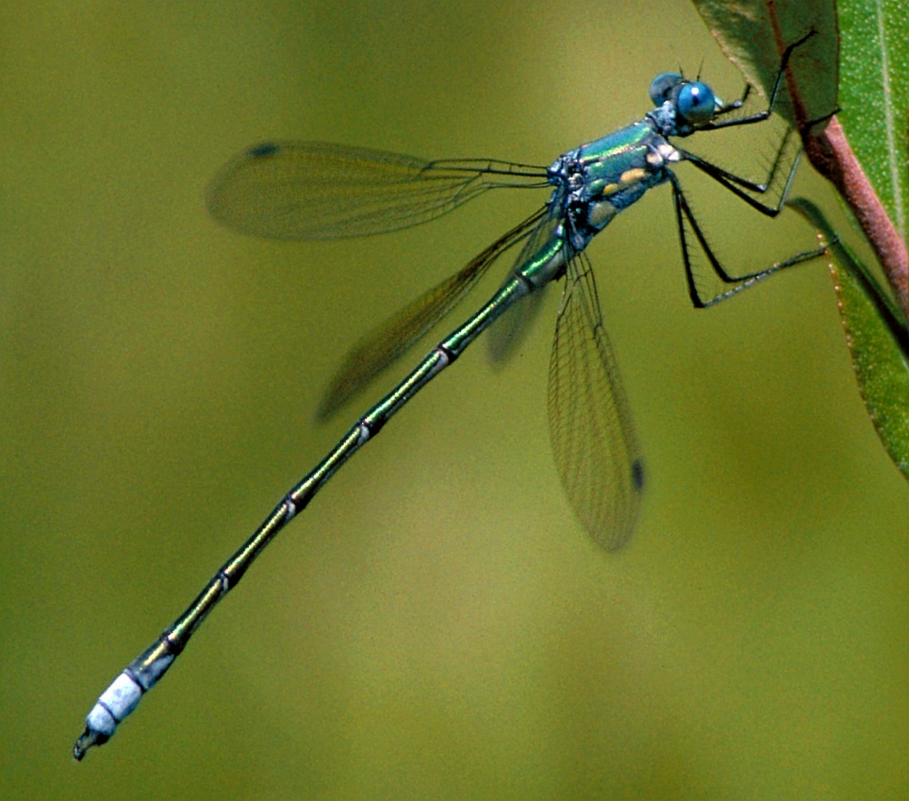
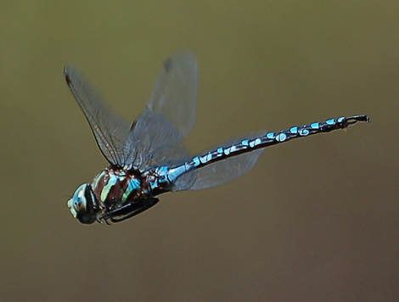
Dragons on the Wing: Exploring Dragonflies!

Slide 2
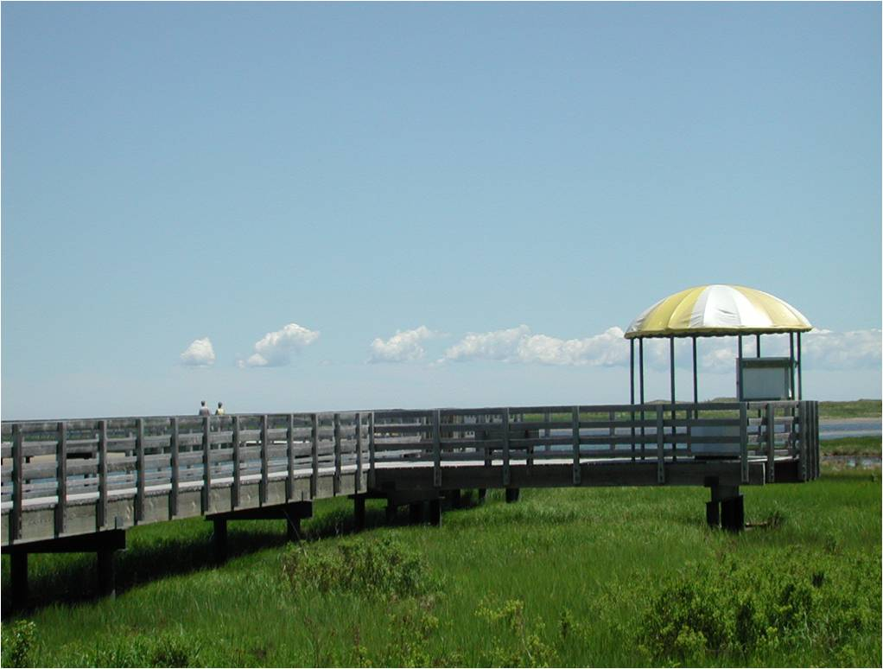

Slide 3
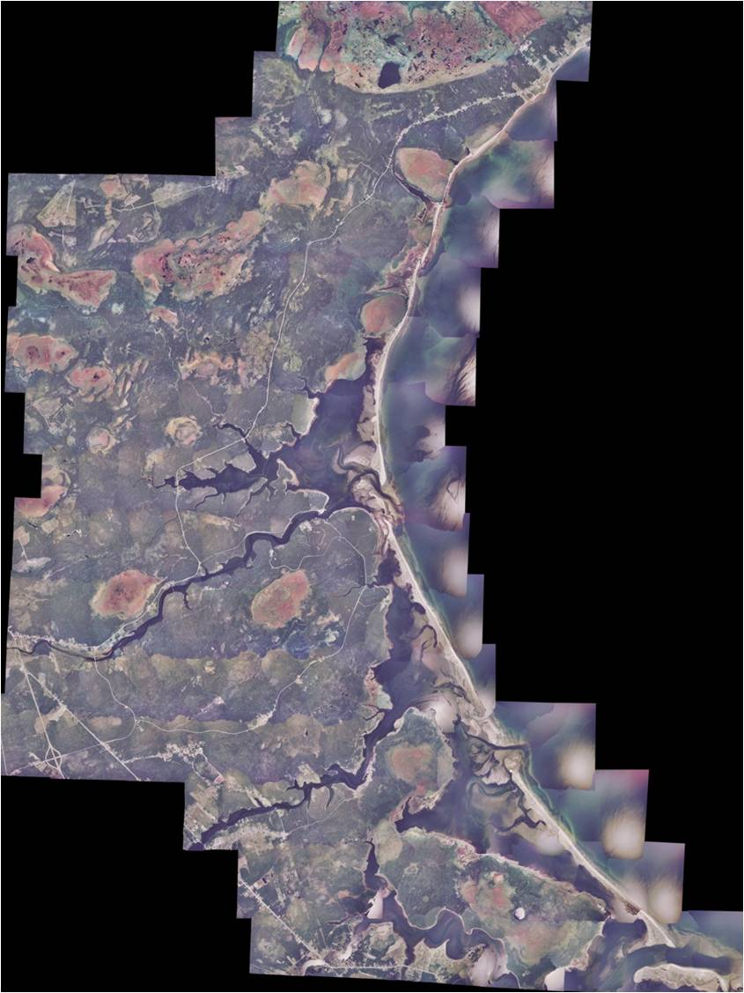

Slide 4
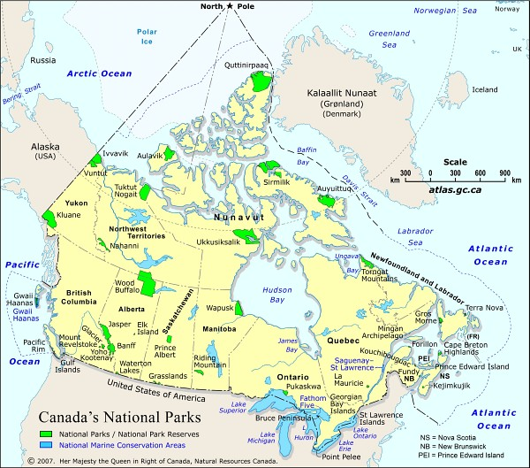

Slide 5
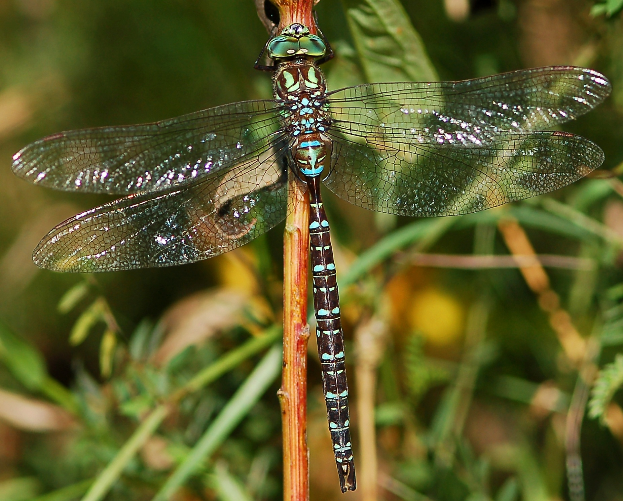
The Shadow Darner: a dragonfly

Slide 6
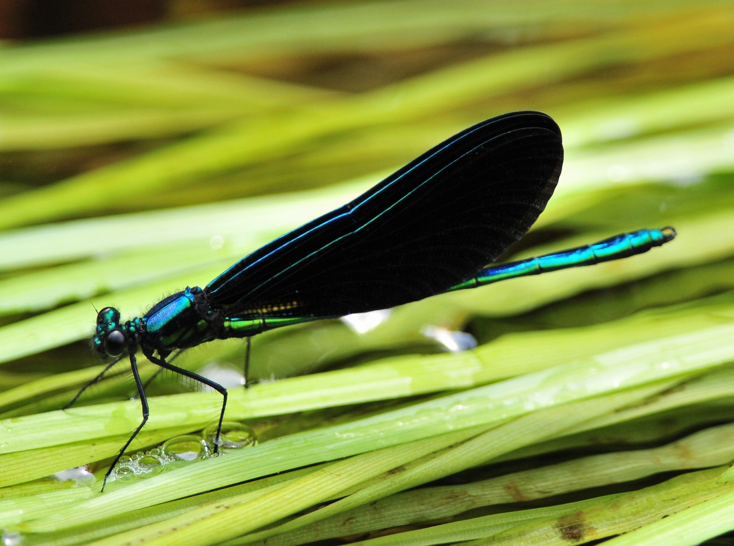
The Ebony Jewelwing: A damselfly

Slide 7
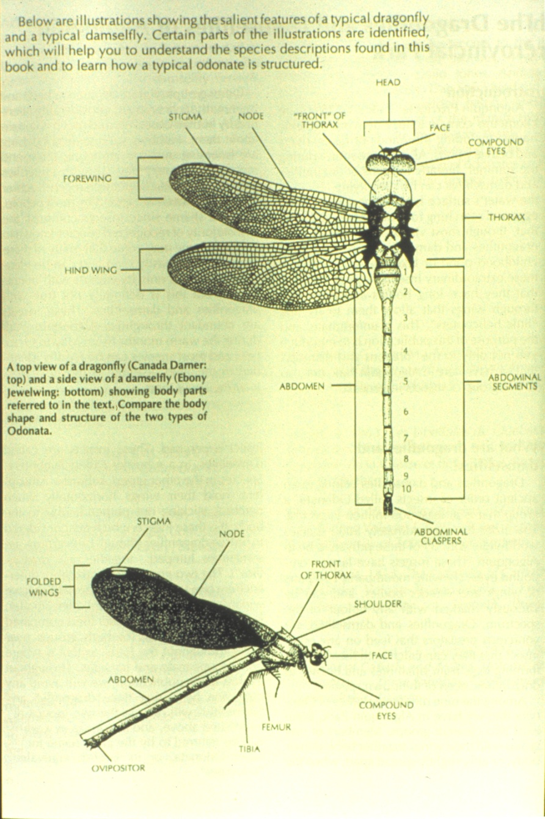
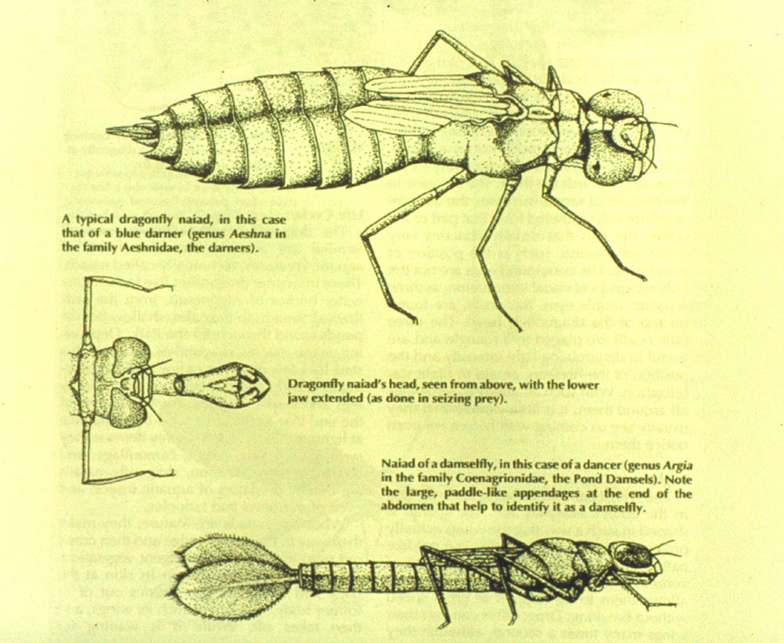
A few technical details…

Slide 8
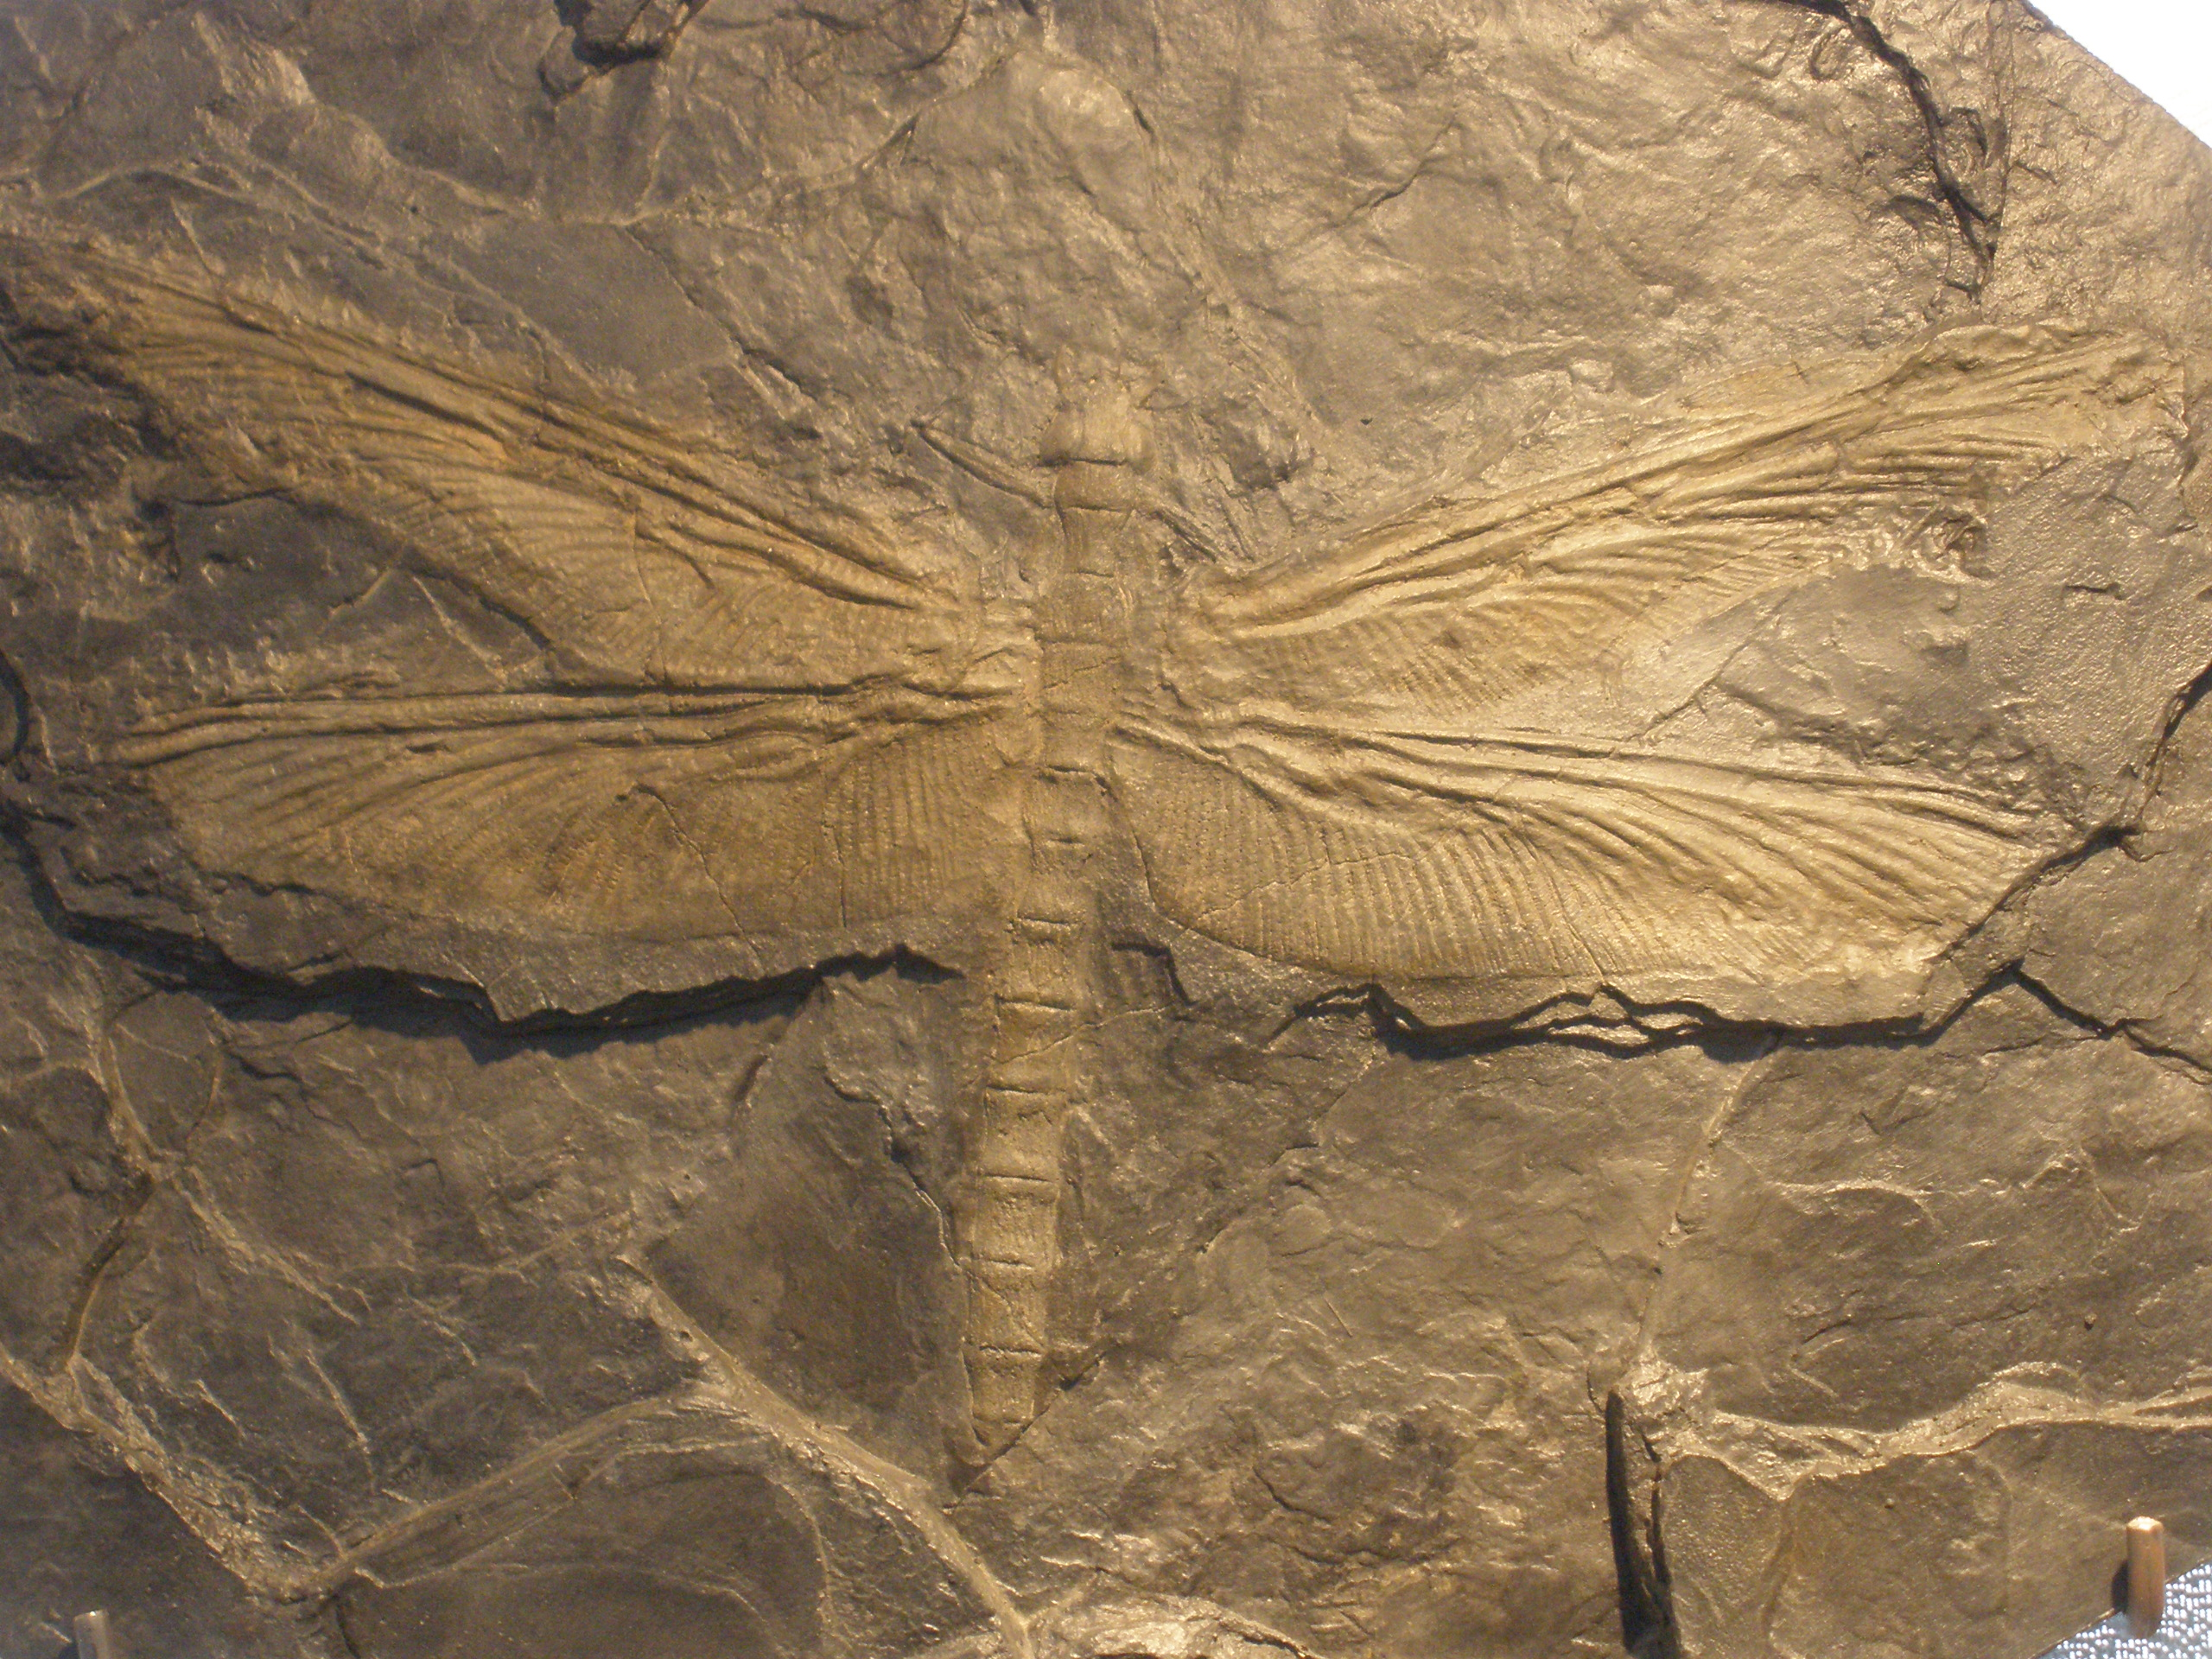
Meganeura monyi: 300 MYA

Slide 9
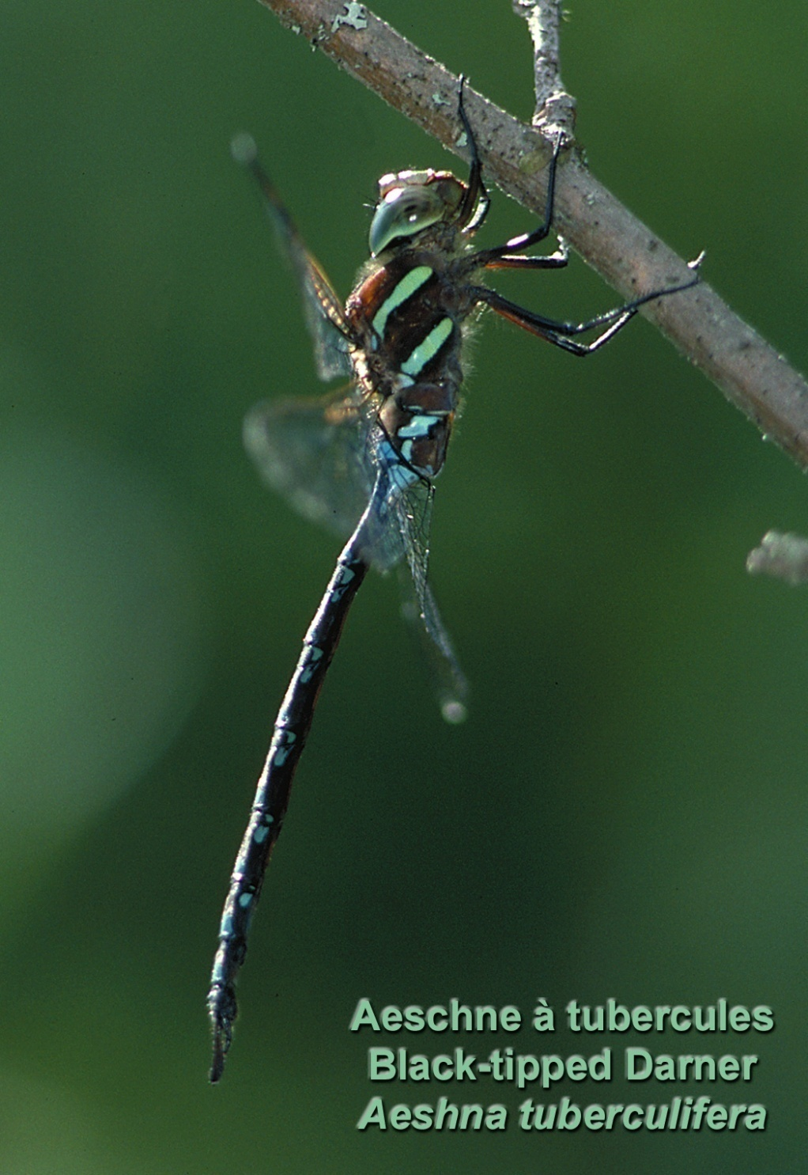
Q. Why are they important?
Predatory insects
Near the top of the Food Chain
Their eyes are among the most complex in the insect world, their flight among the most powerful…
Because of their aquatic lifestyle, very sensitive to disturbance…
Despite the ecological role, we still know very little about them…
Potentially excellent indicators of the health of the environment
Several species in Canada are already at risk or possibly even endangered!

Slide 10
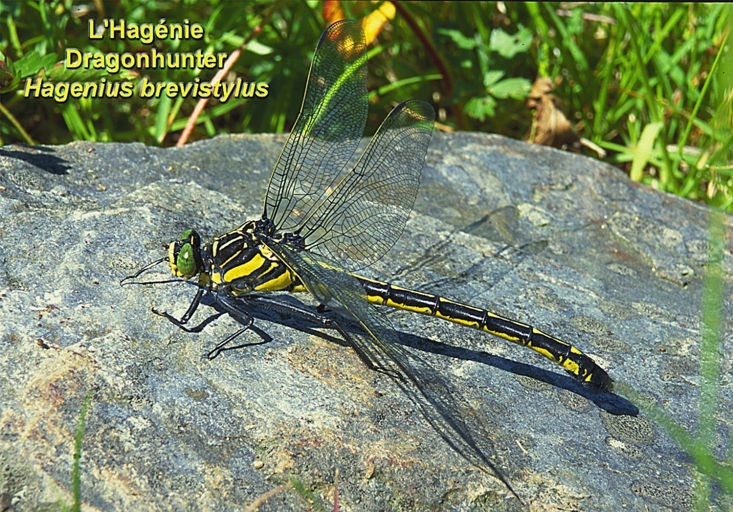
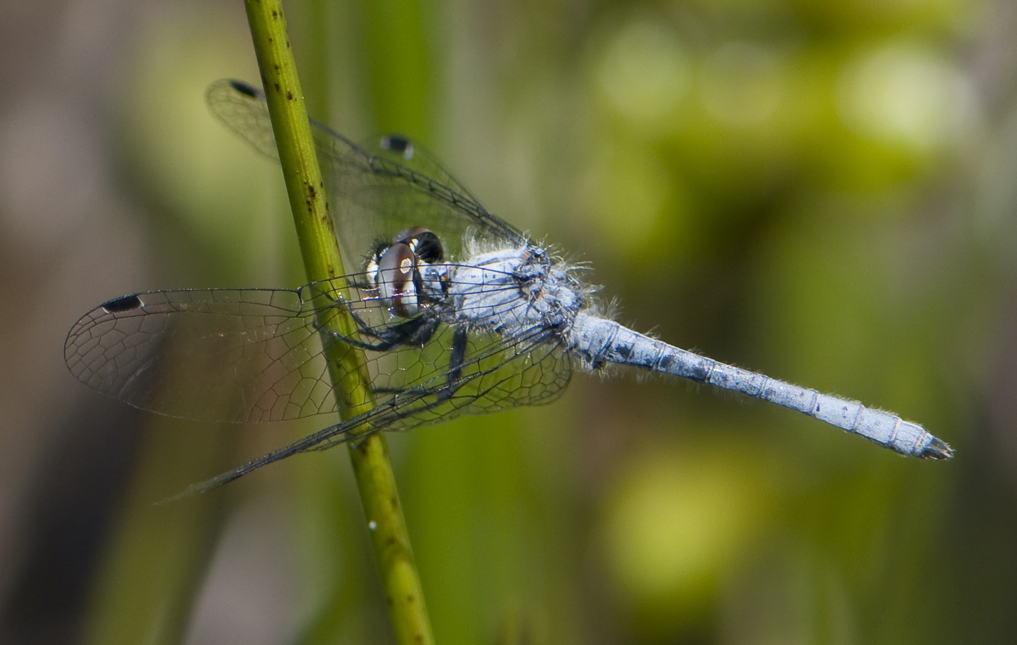
From the smallest to the biggest in New Brunswick…
The Elfin Skimmer…
2 cm
8 cm

Slide 11
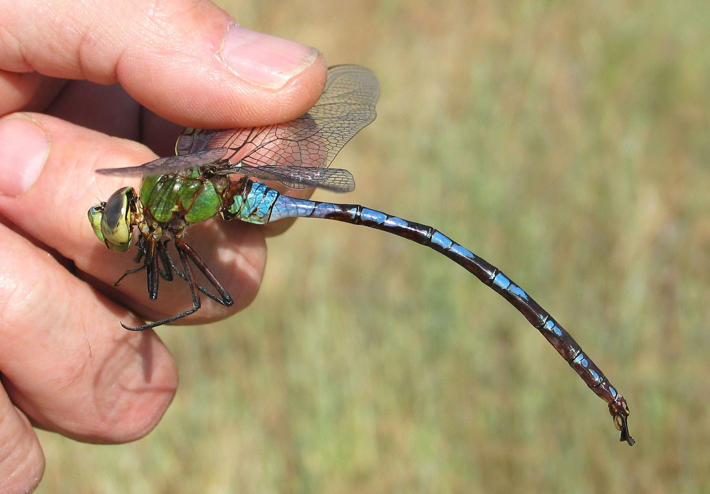
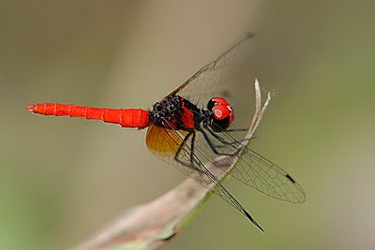
From the smallest to the biggest in the WORLD…
The GIANT Petaltail
The Pygmy Scarlet Skimmer…
1.8 cm
12 cm

Slide 12
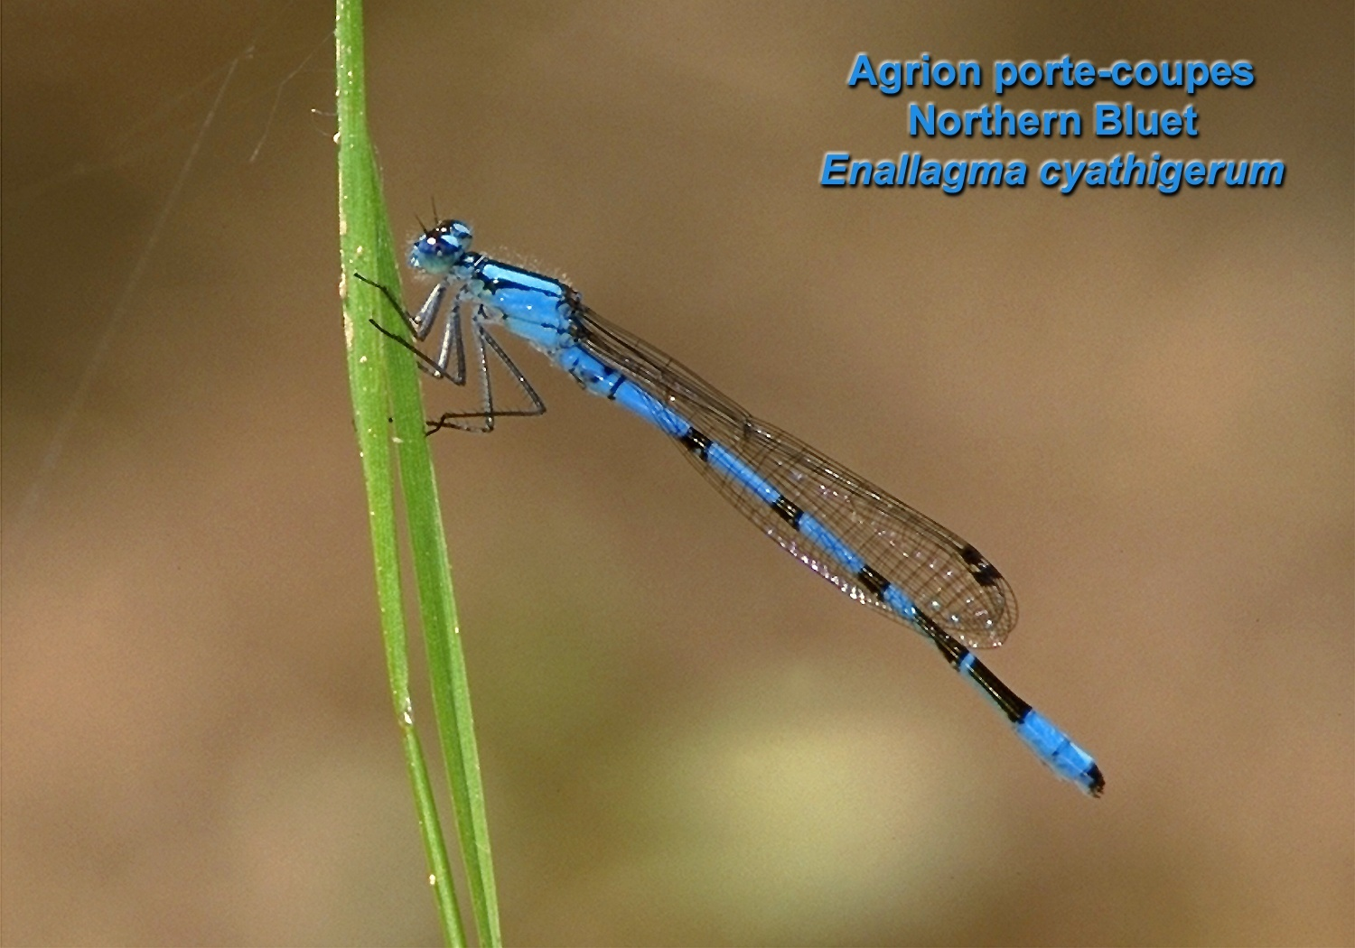
An introduction to the species
Part 1: the Damselflies- 21 species in the park

Slide 13
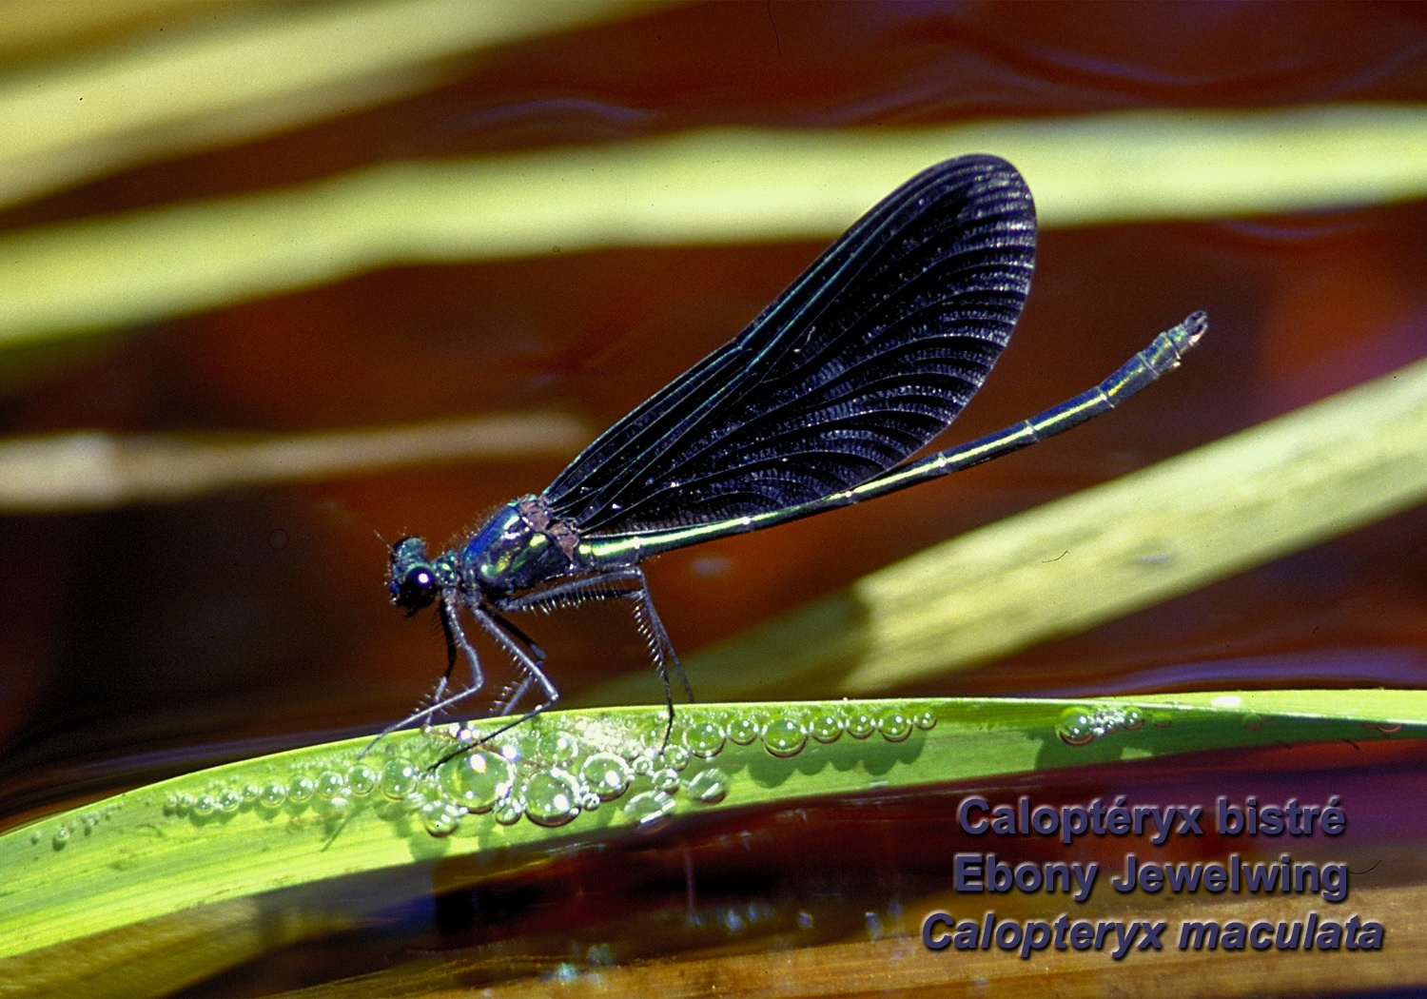
Jewelwings : 1 species in the park,
3 species in NB

Slide 14
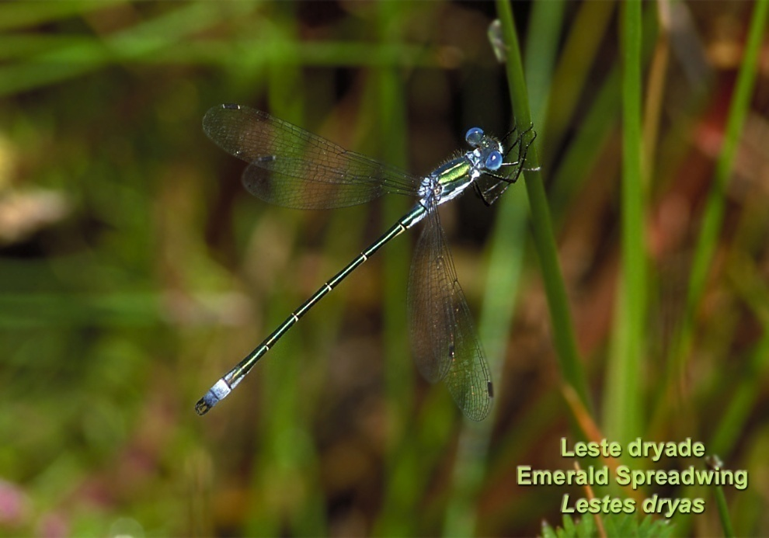
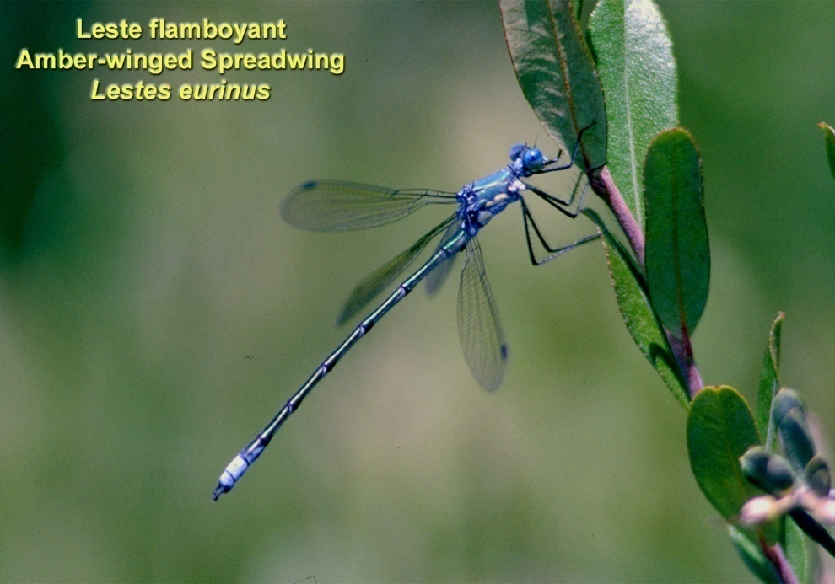
Spreadwings

Slide 15
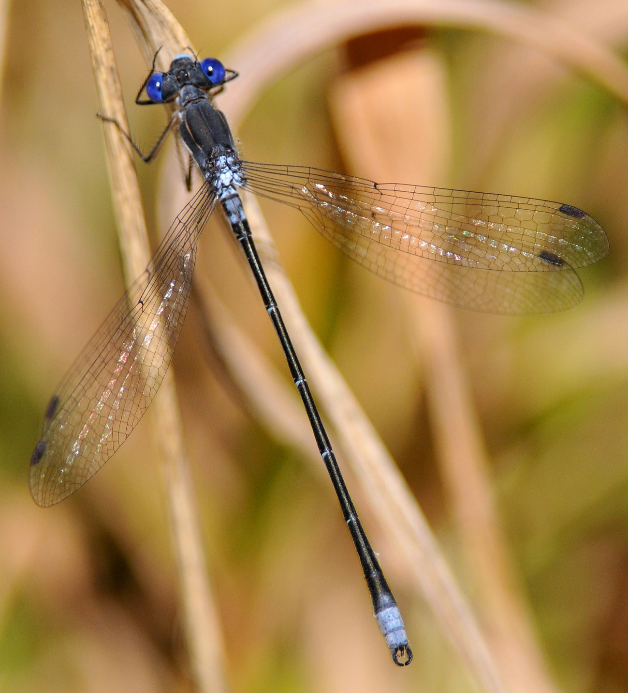
The Spotted Spreadwing…

Slide 16
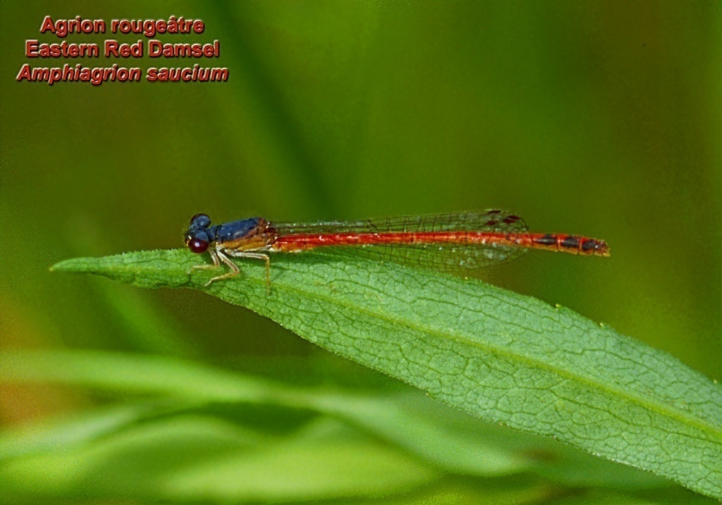
(Pond Damsels):
Most of the species

Slide 17
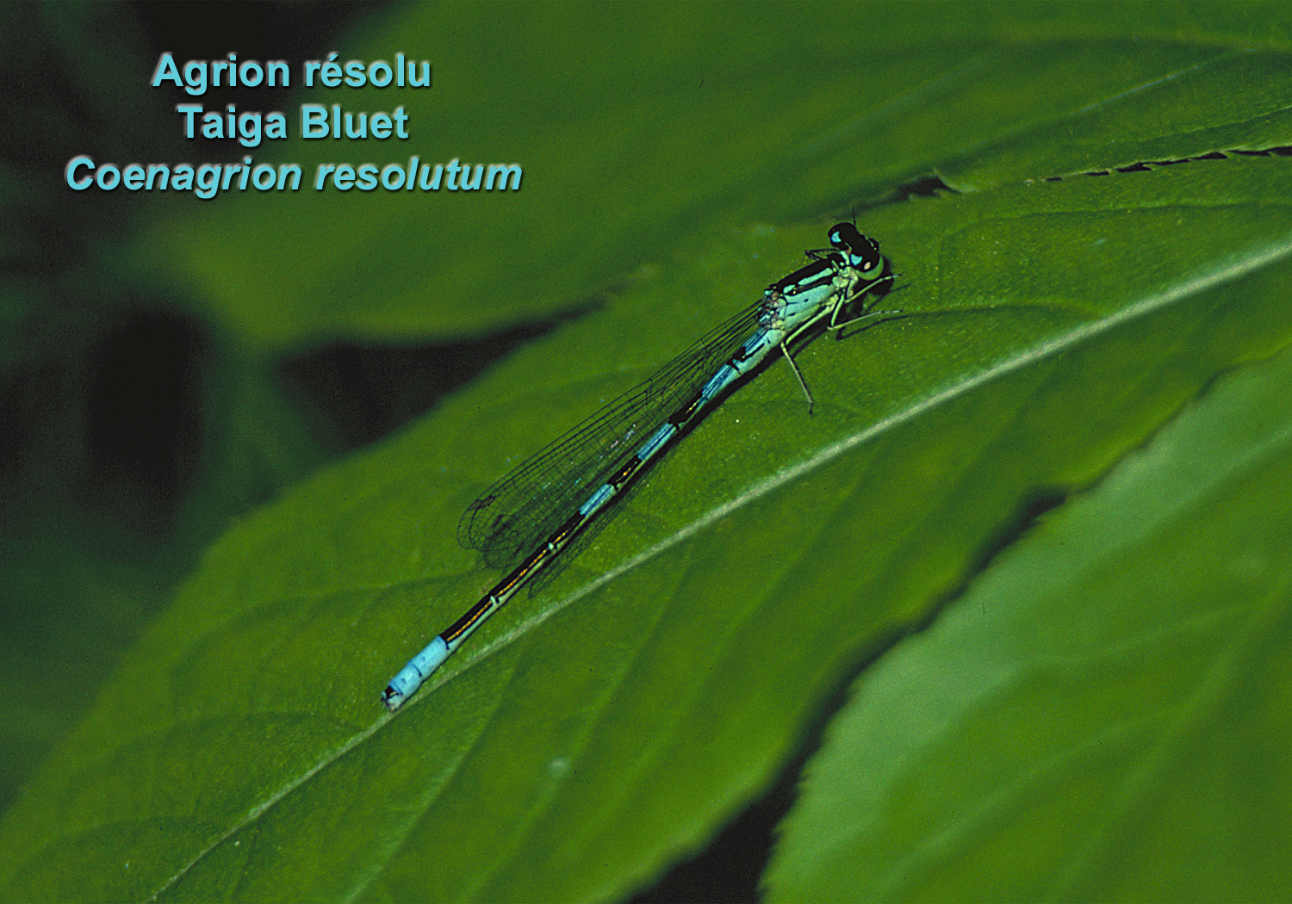

Slide 18
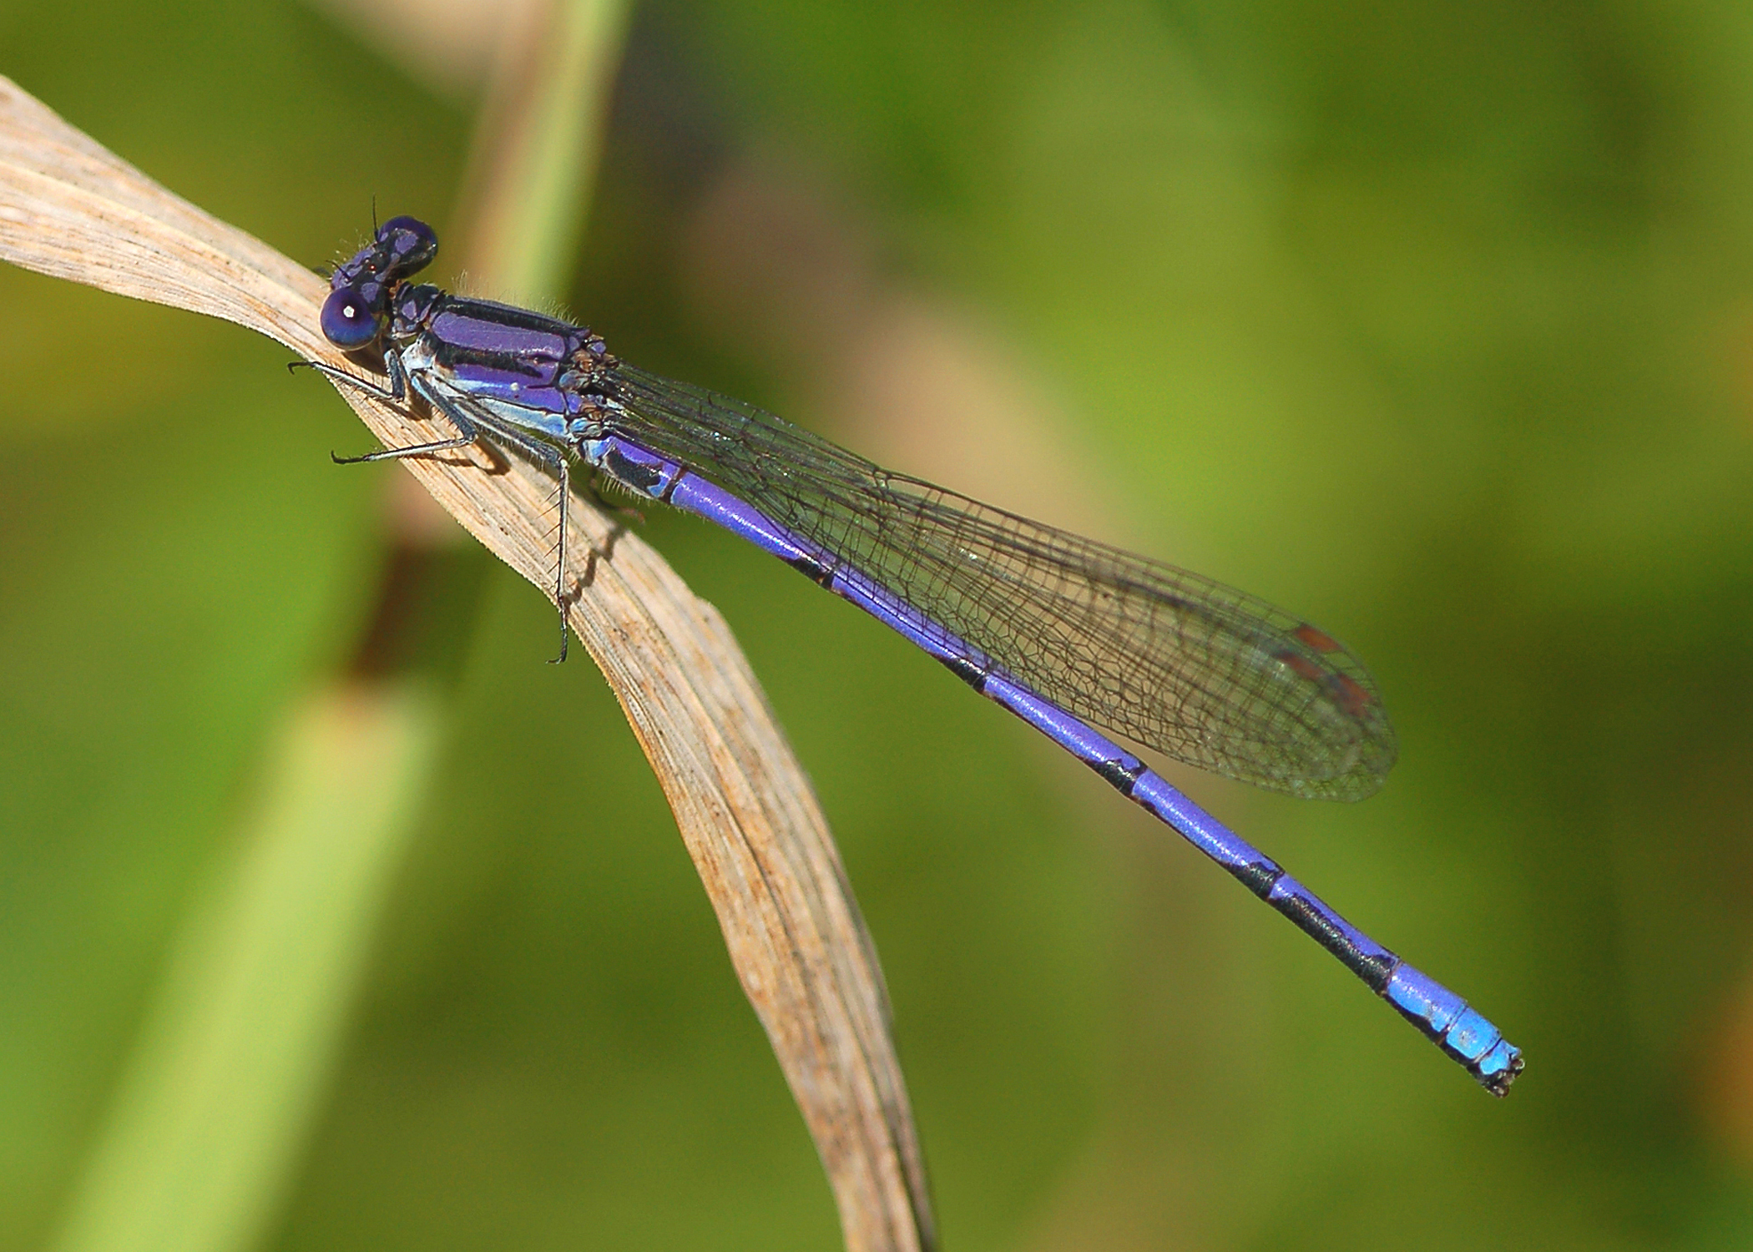
The Violet Dancer…

Slide 19
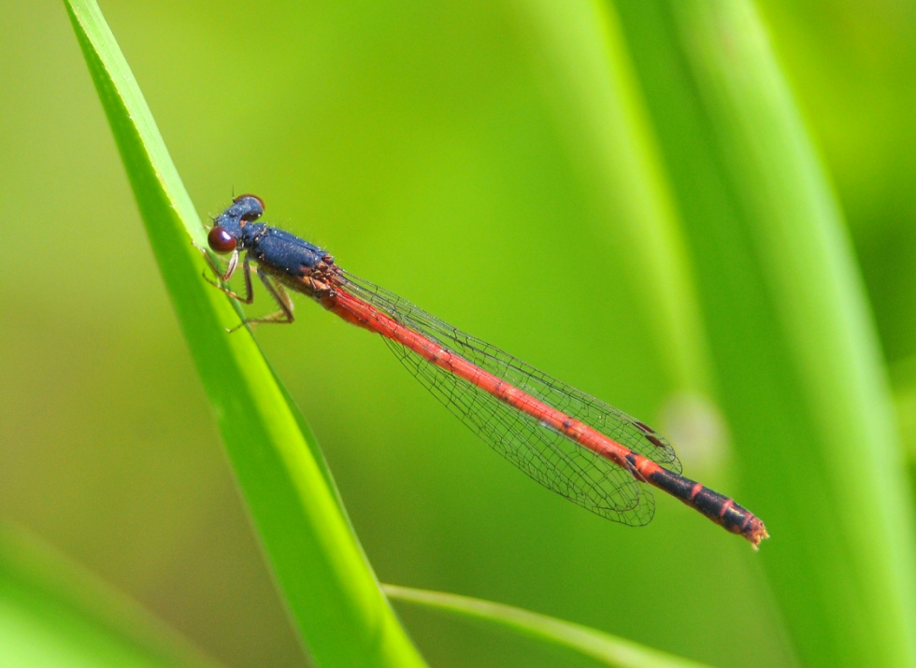
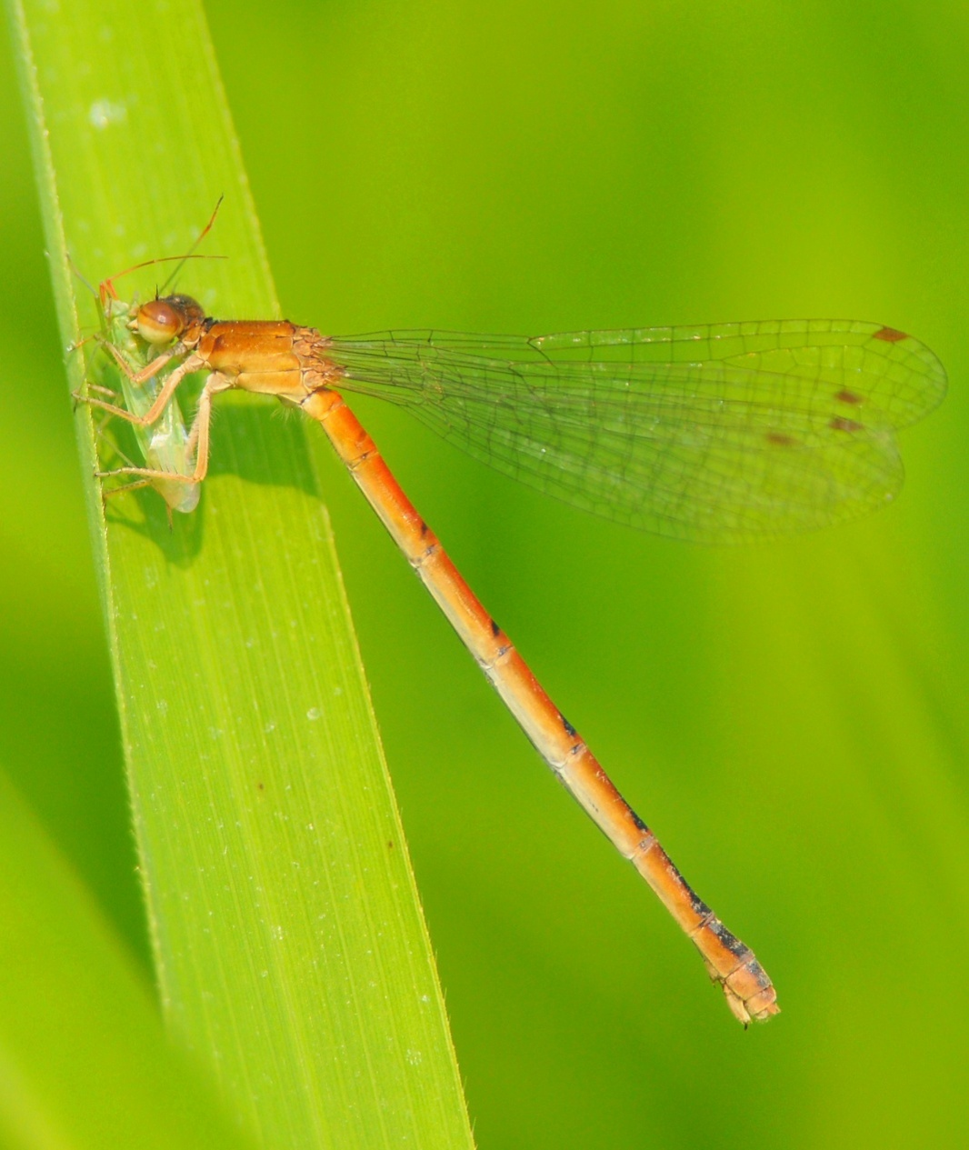
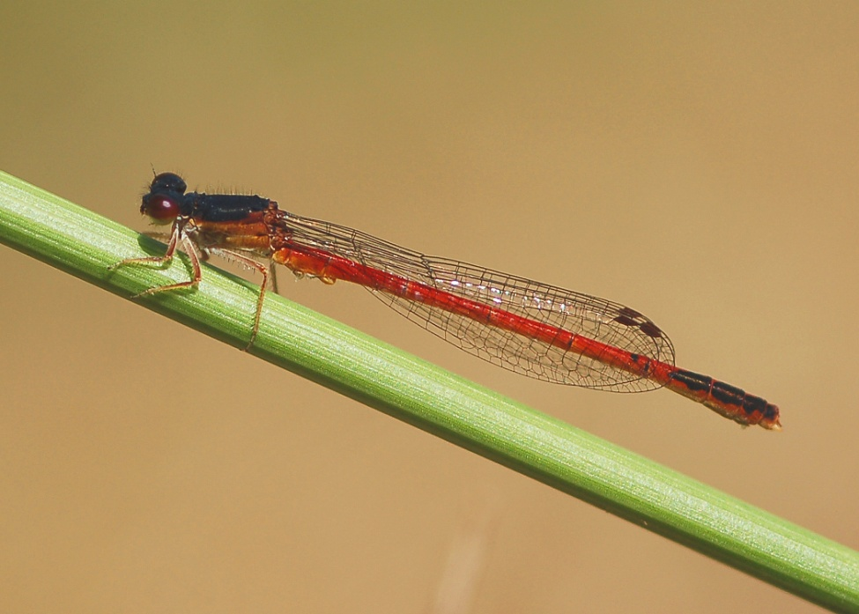
The Eastern Red Damsel

Slide 20
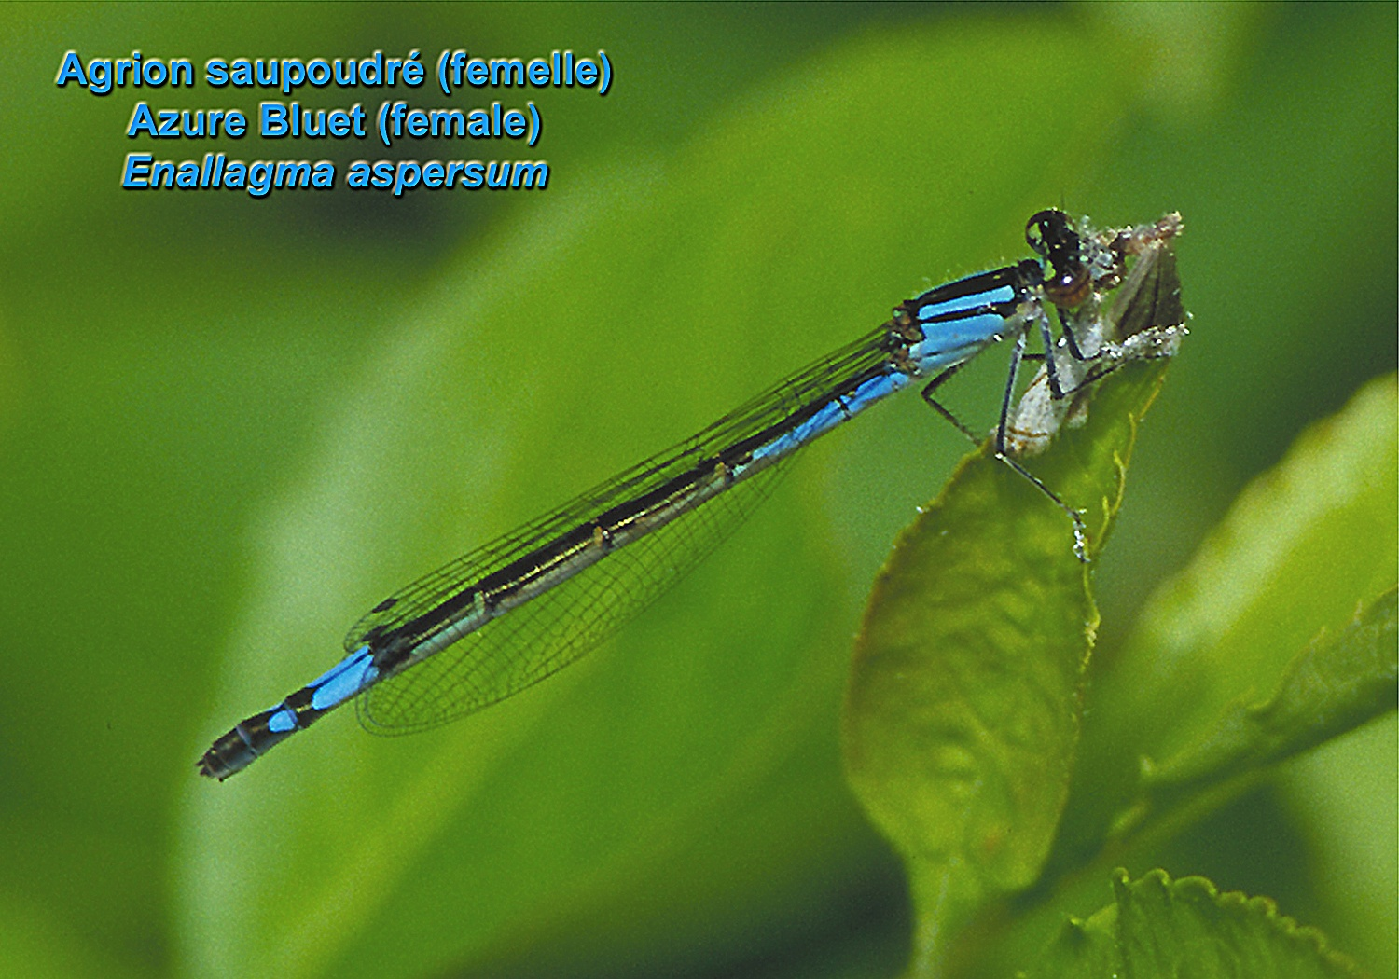

Slide 23
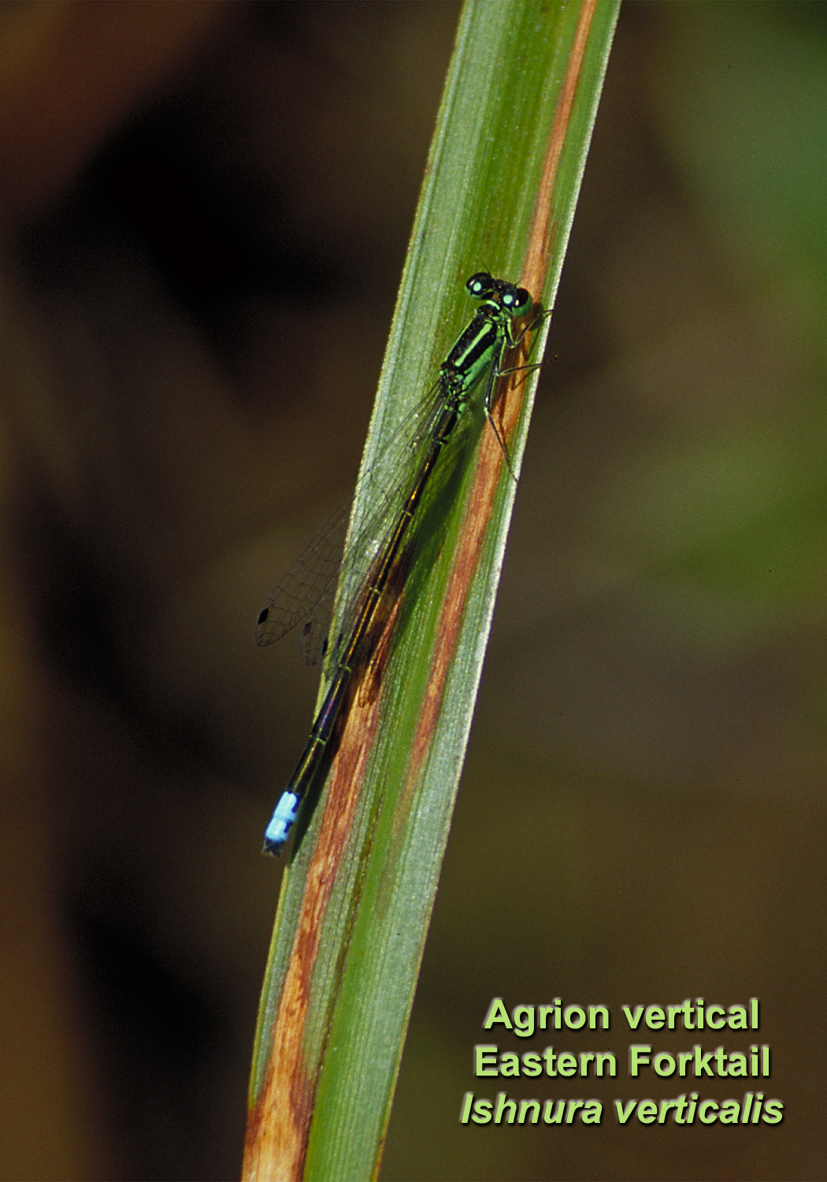

Slide 24
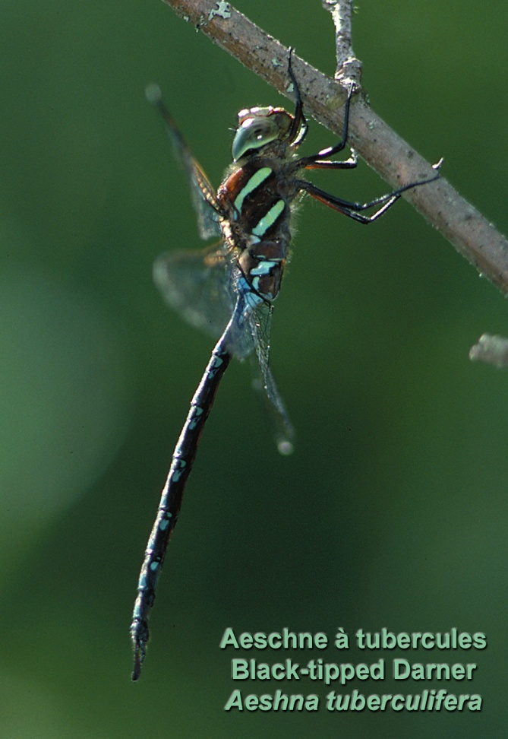
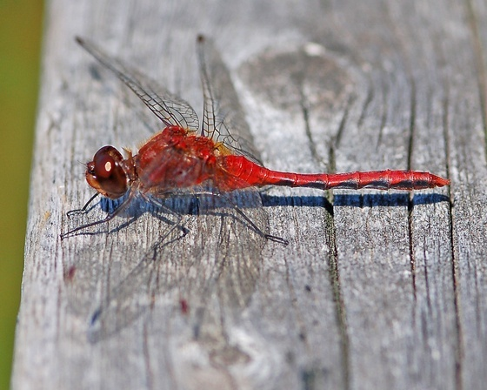
Part 2: Dragonflies-
44 species in the park

Slide 25
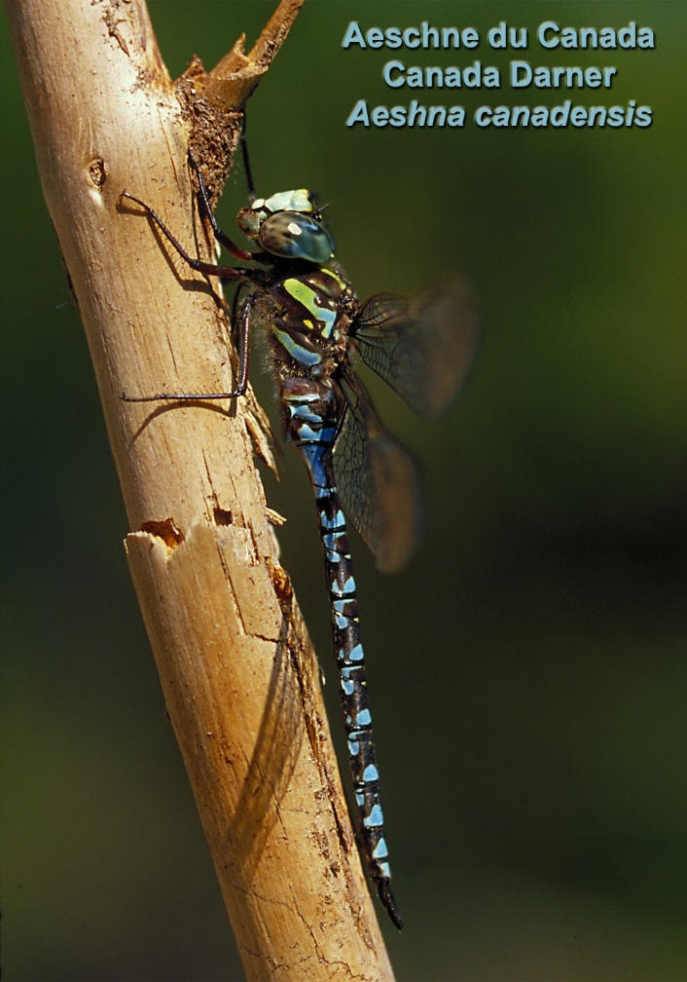
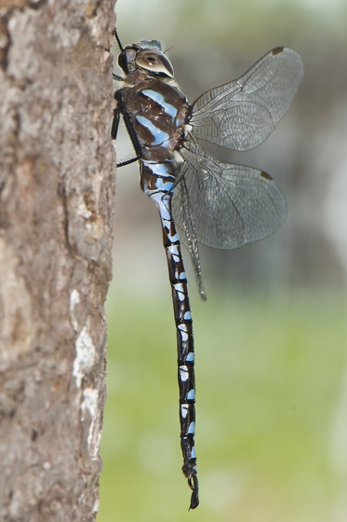
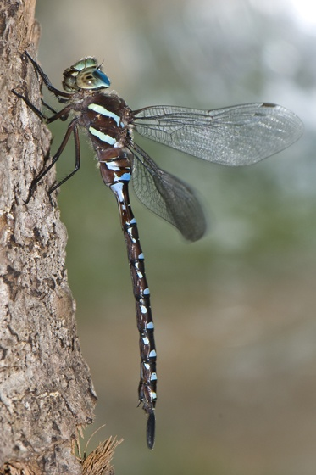
Darners

Slide 26
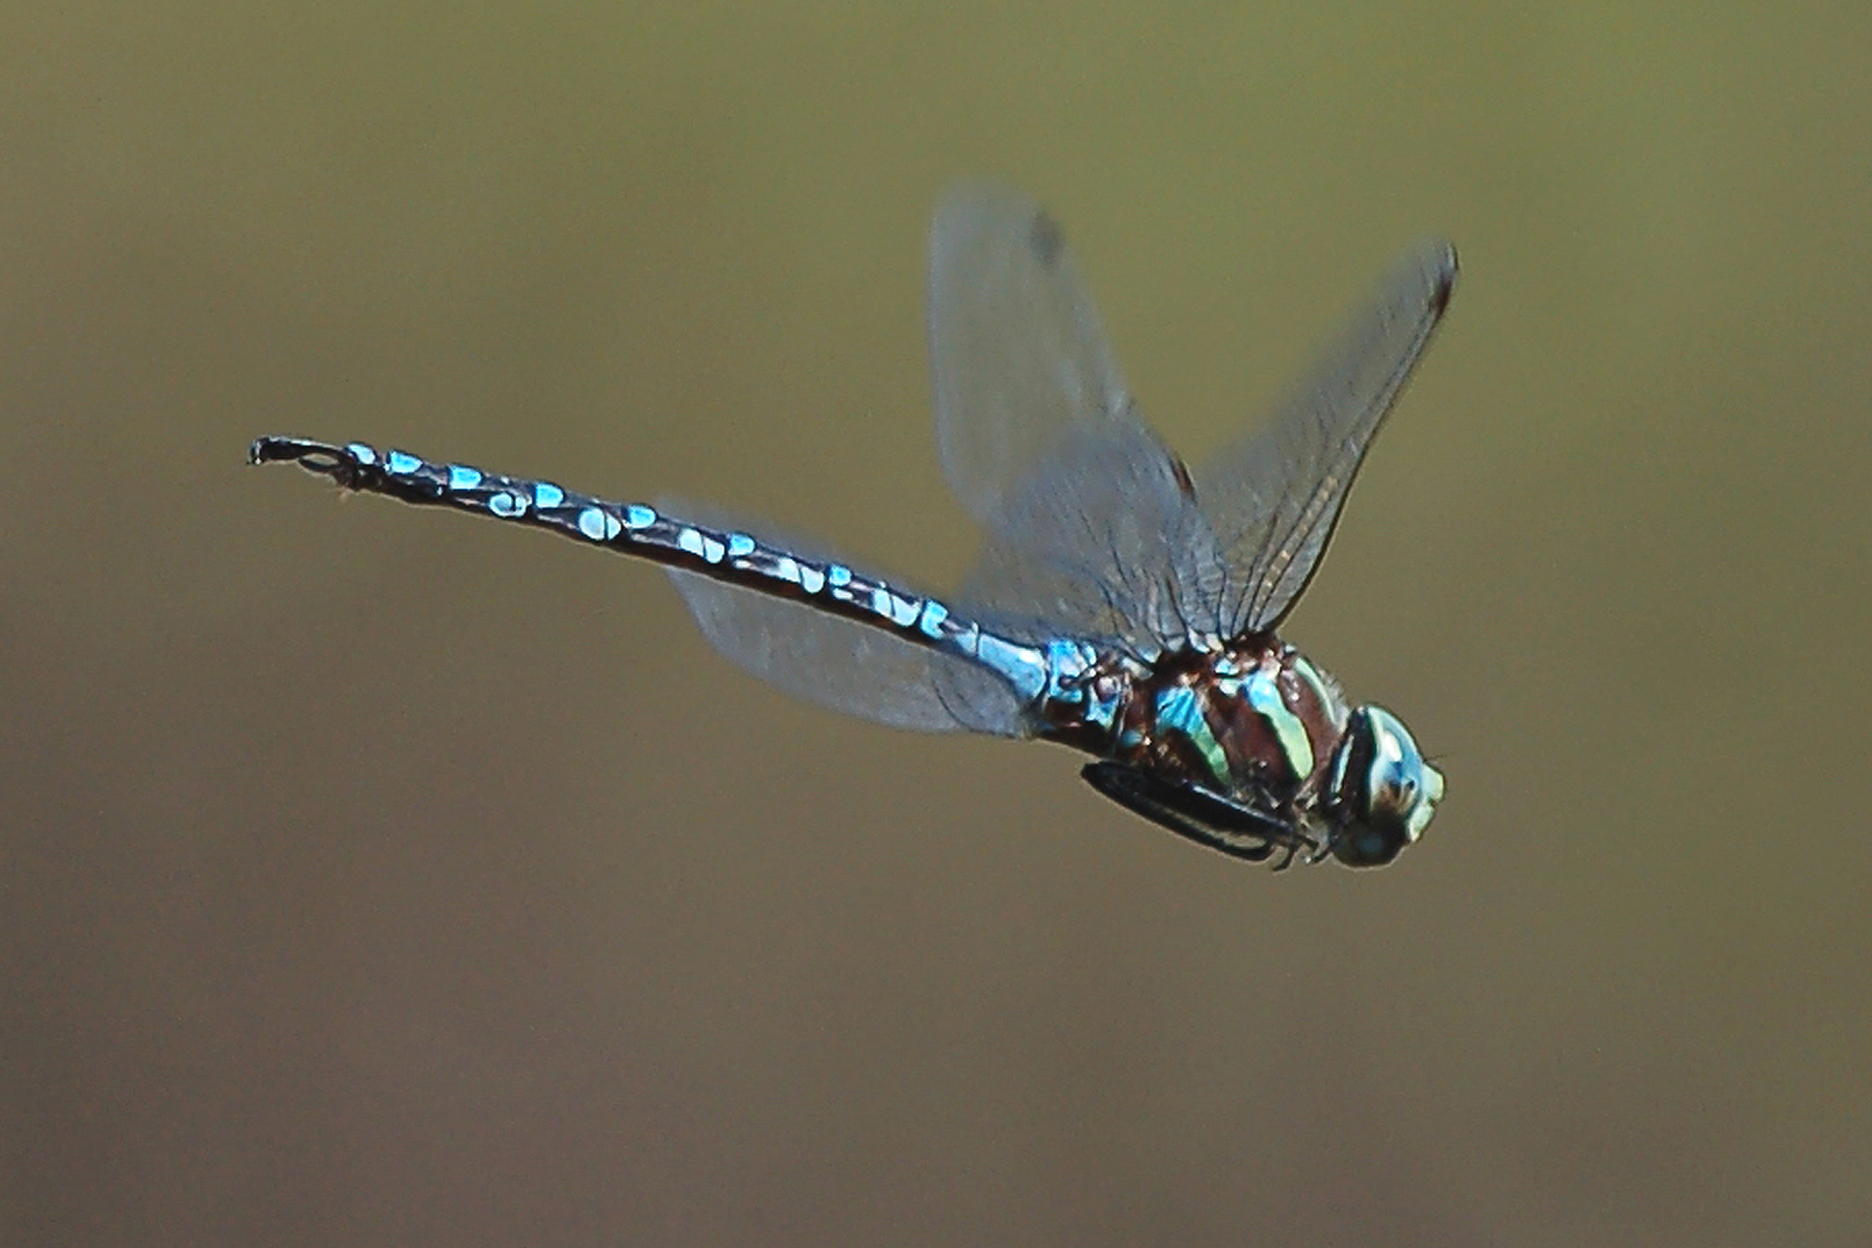
Which Darner am I?

Slide 27
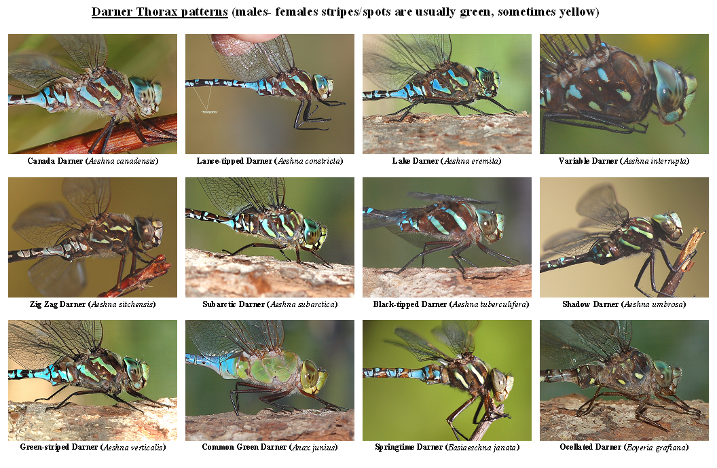

Slide 28
Variable Darner in flight

Slide 29
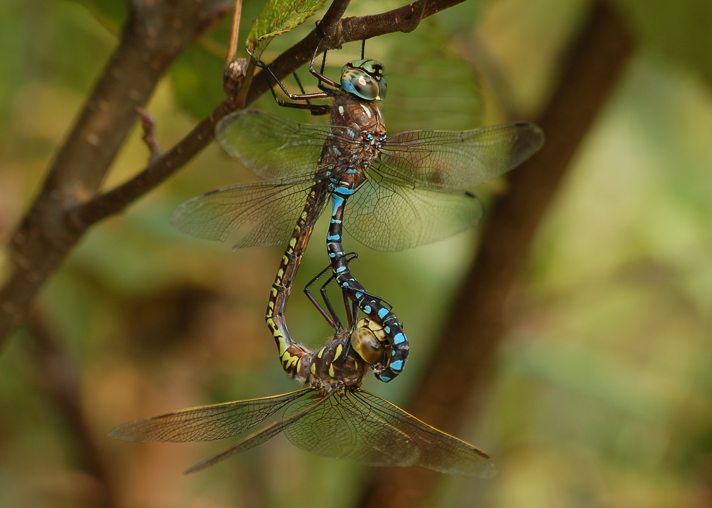
Variable Darners mating

Slide 30
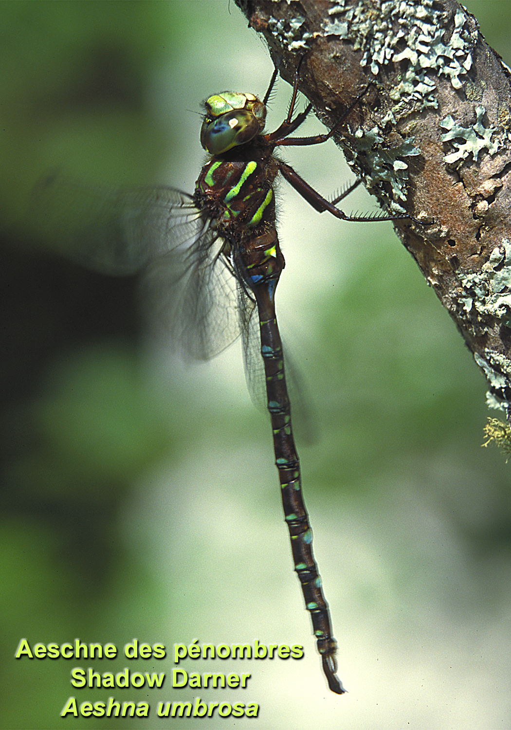

Slide 31
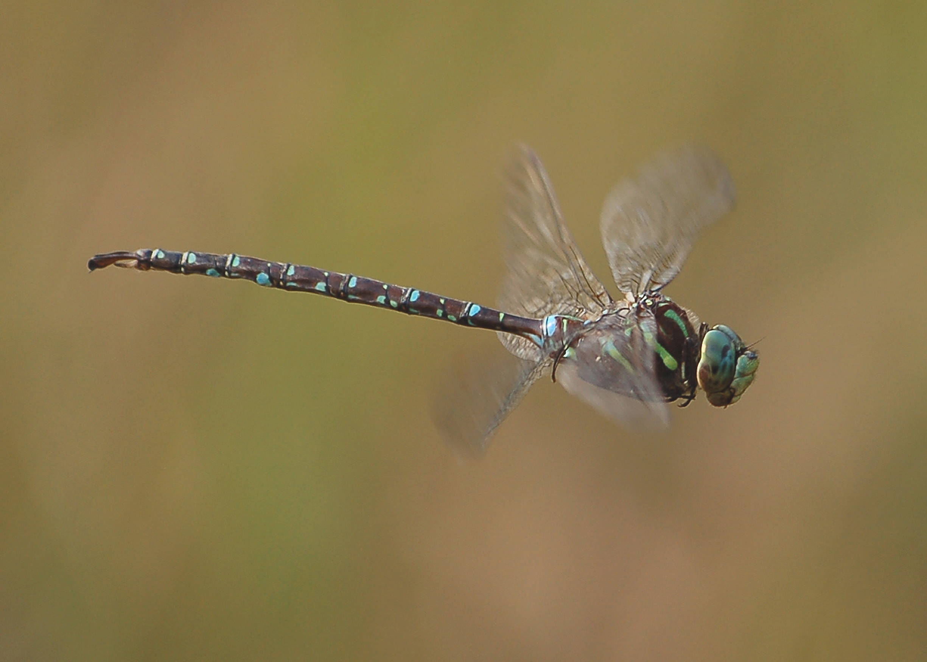
Shadow Darner in flight

Slide 32
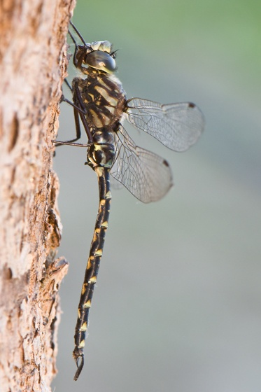
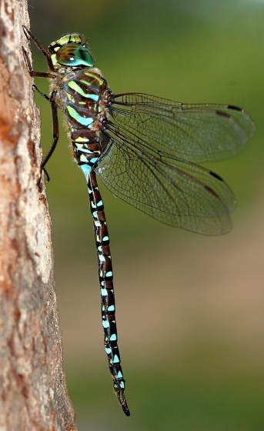
Harlequin Darner and Subarctic Darner

Slide 33
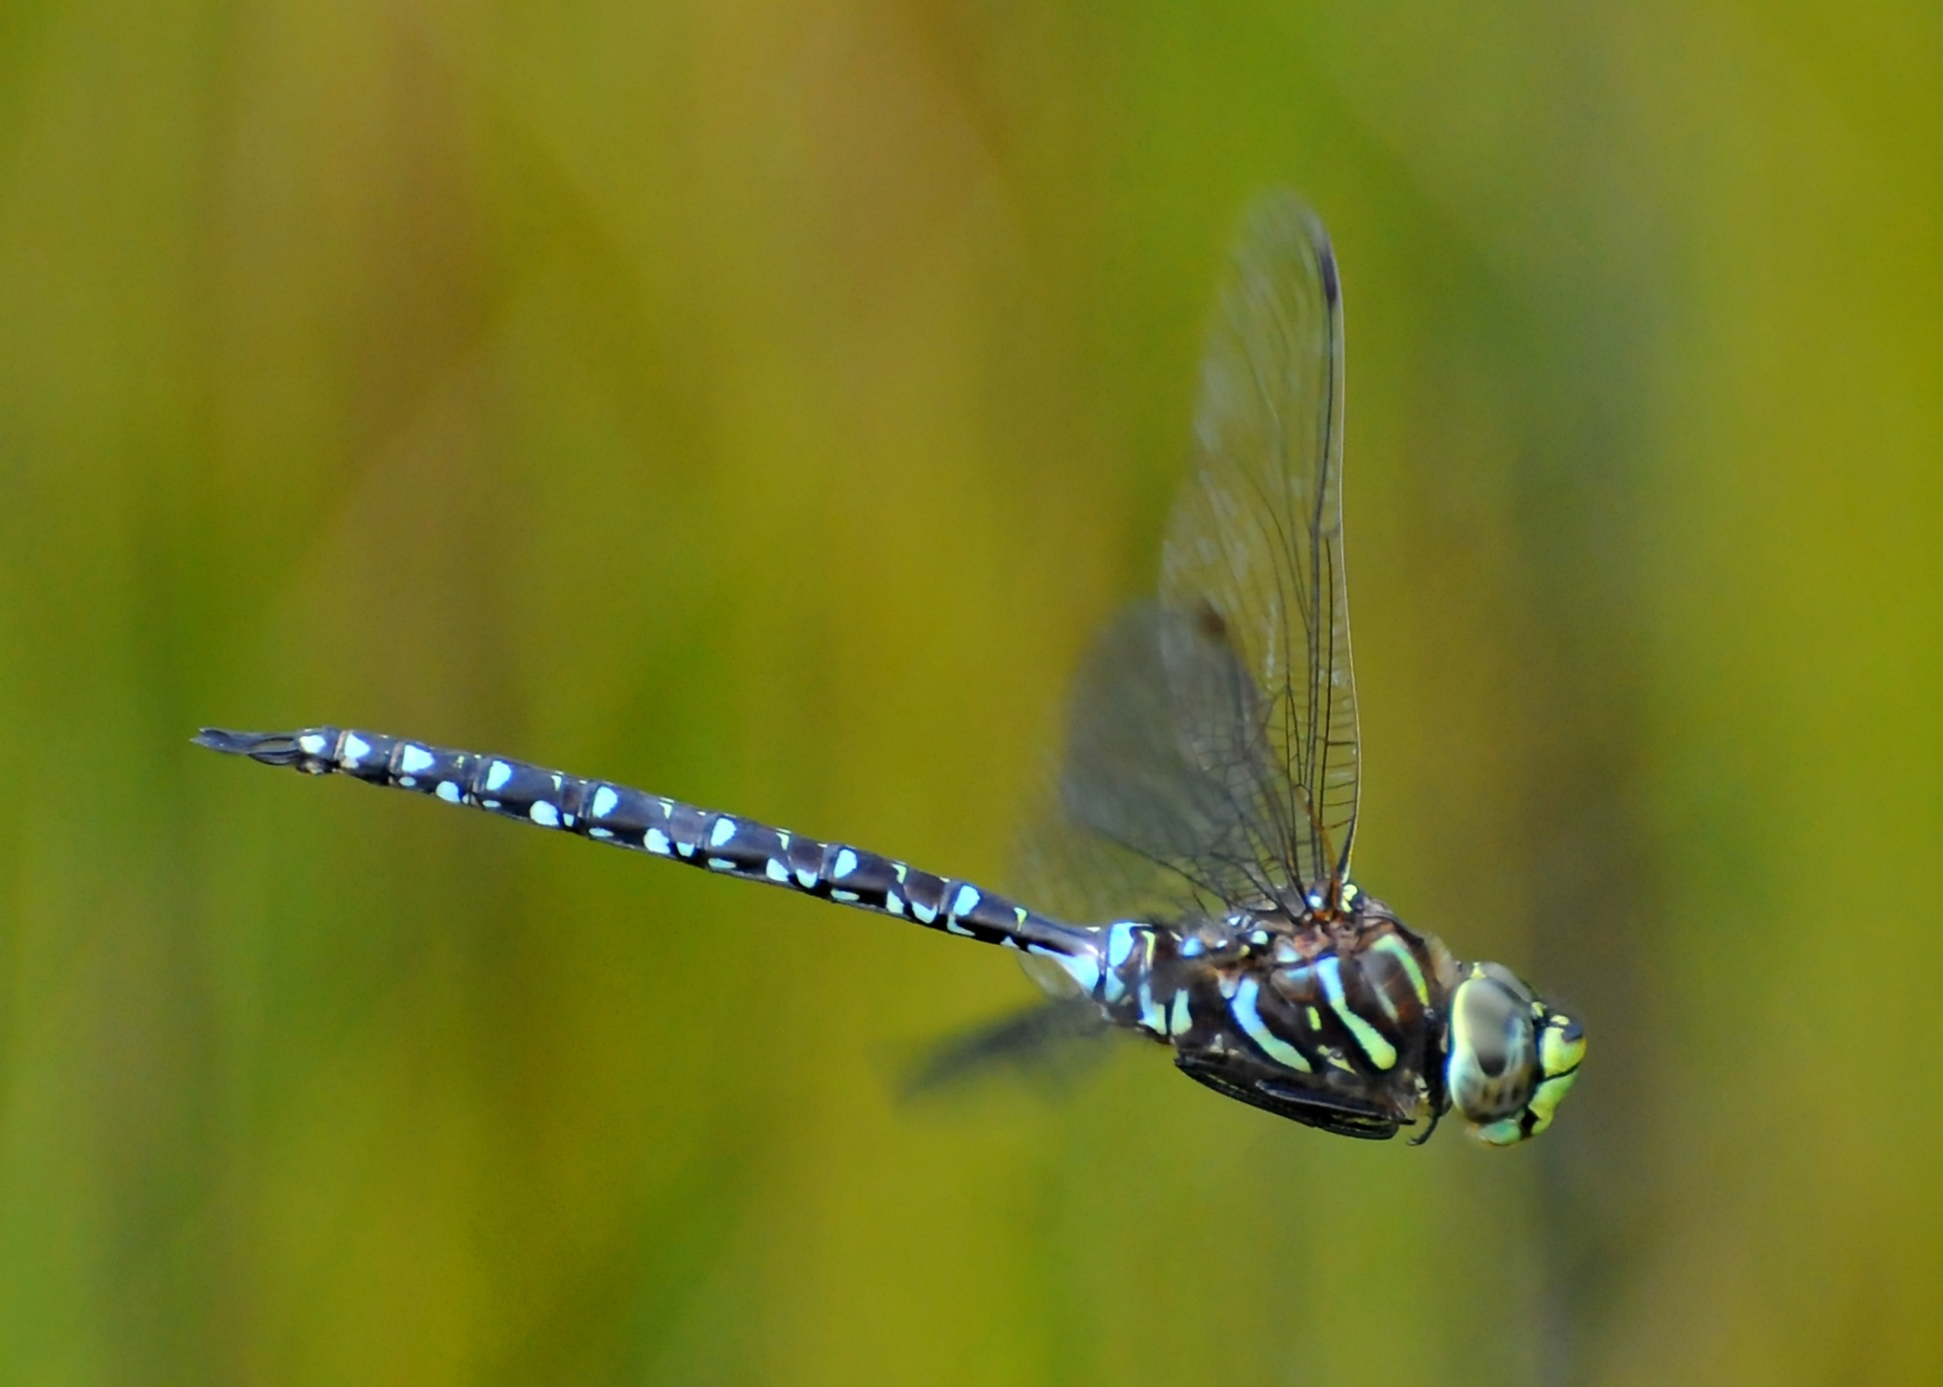
Subarctic Darner in flight

Slide 34
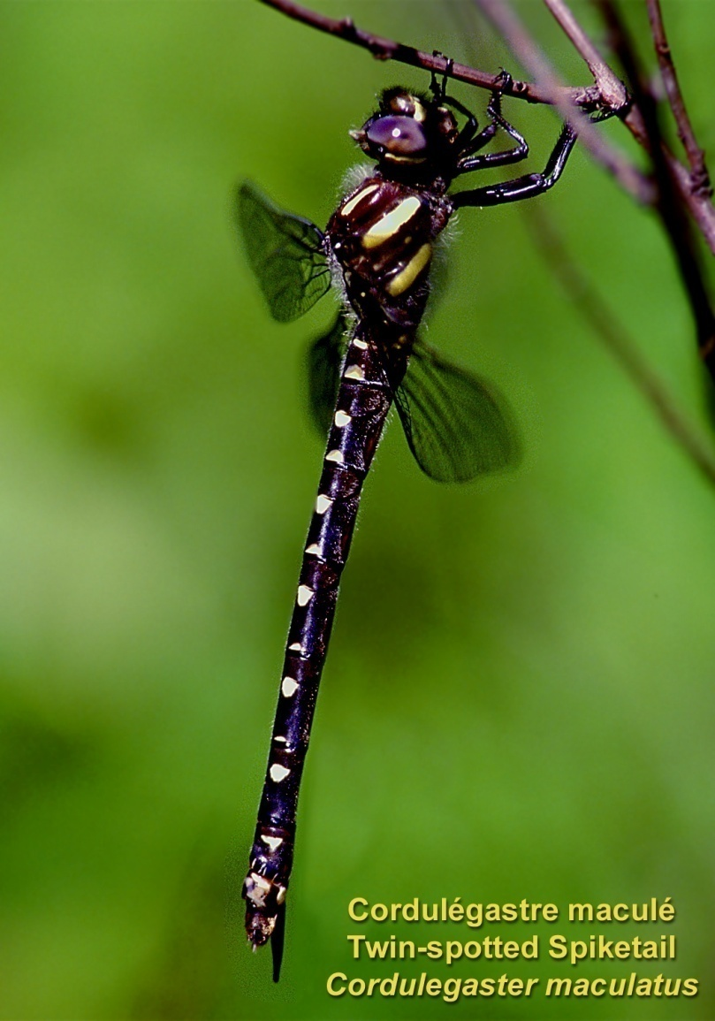
(Spiketails): 2 species

Slide 35
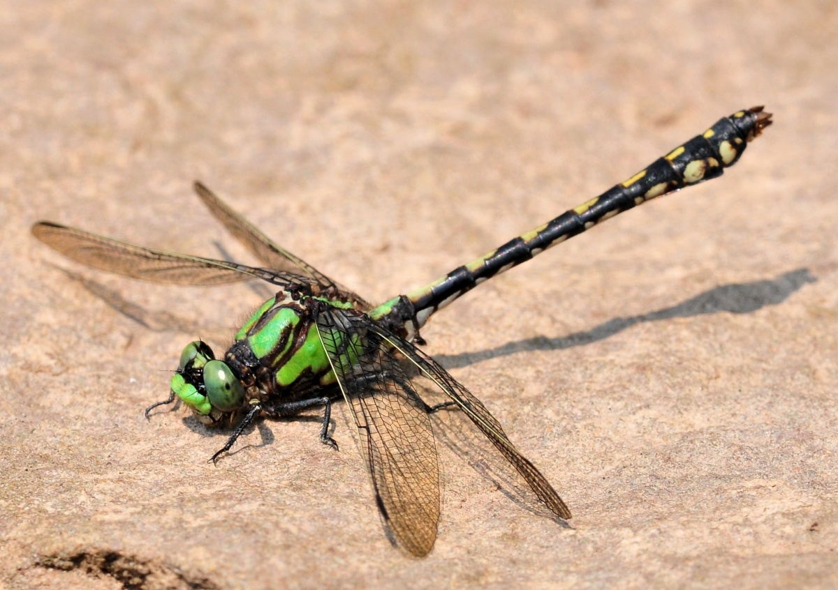
(Clubtails): 20 species in NB, only 2 in the park,
Why?

Slide 36
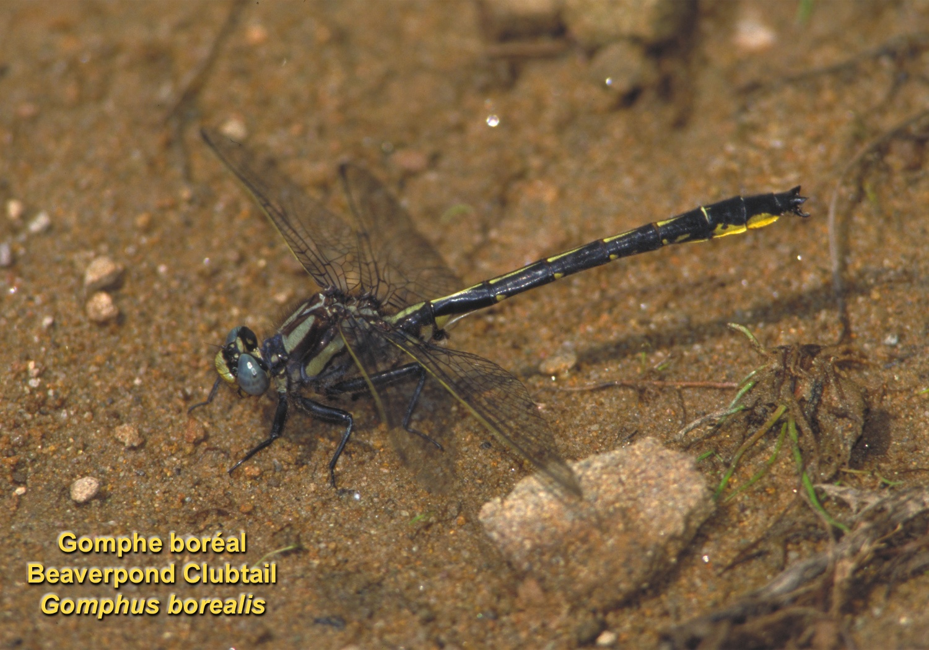

Slide 37
Riffle Snaketail

Slide 38
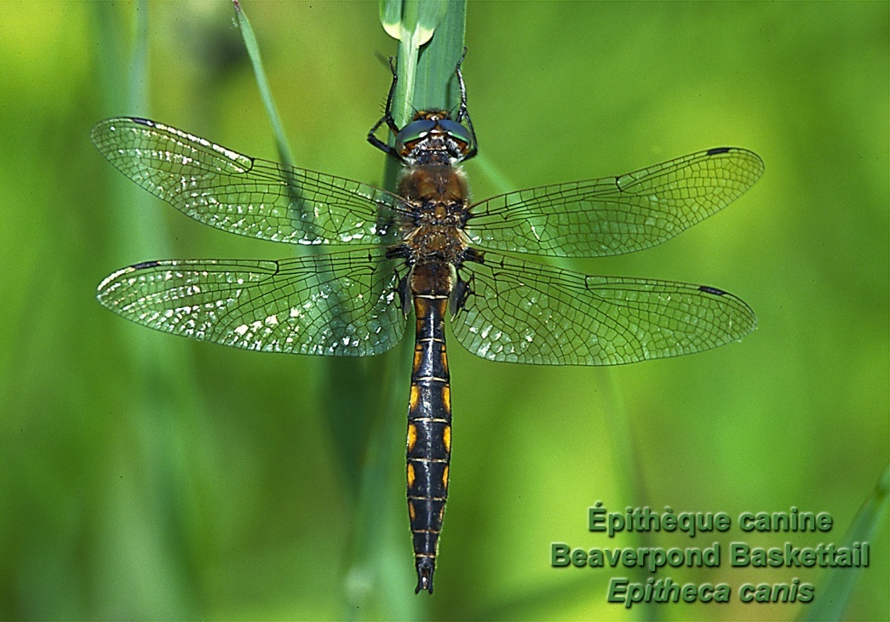
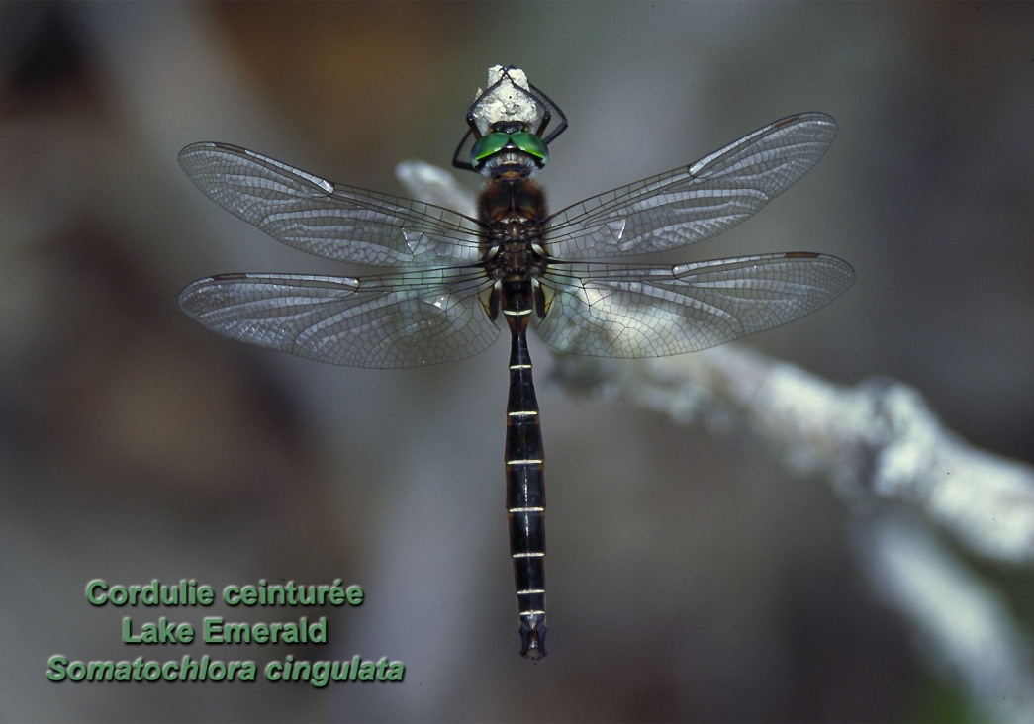
Emeralds

Slide 40
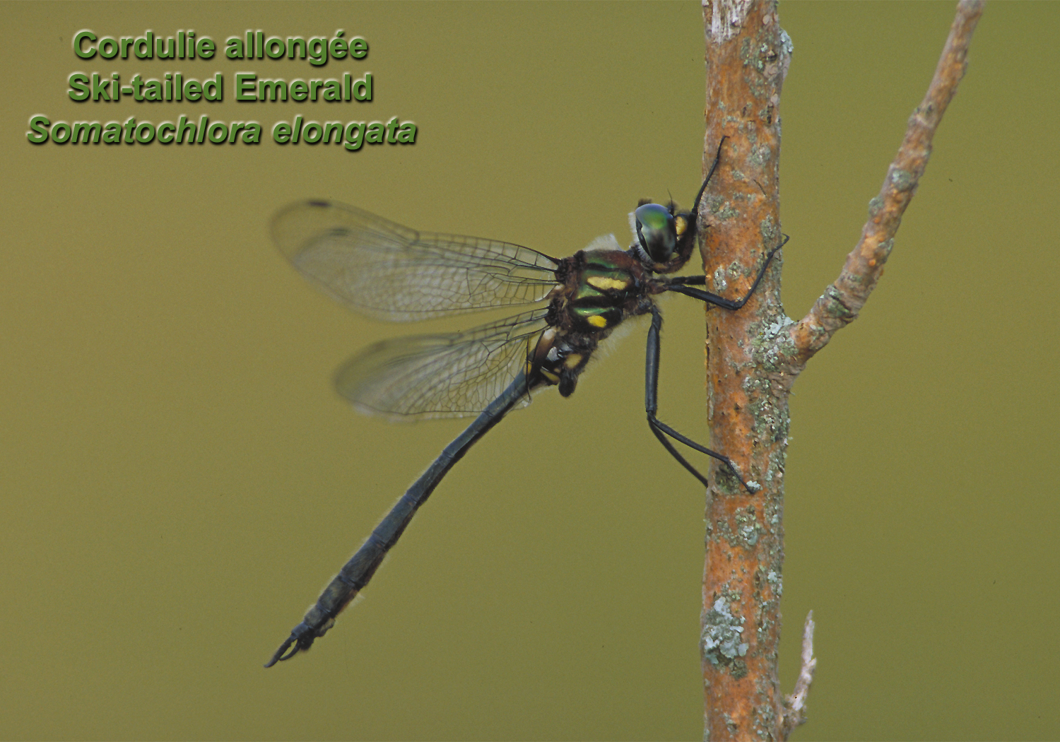

Slide 41
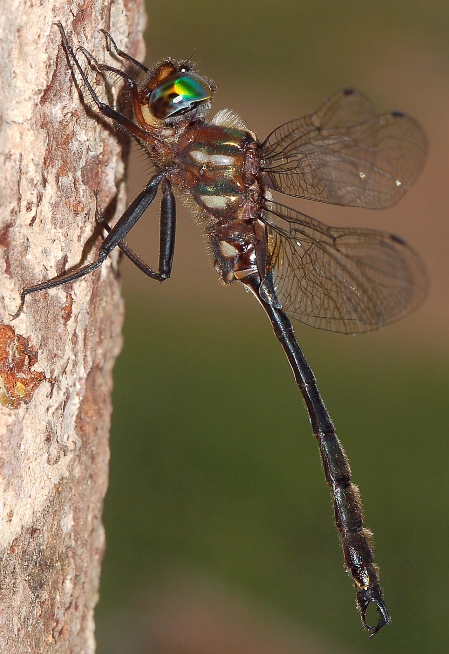
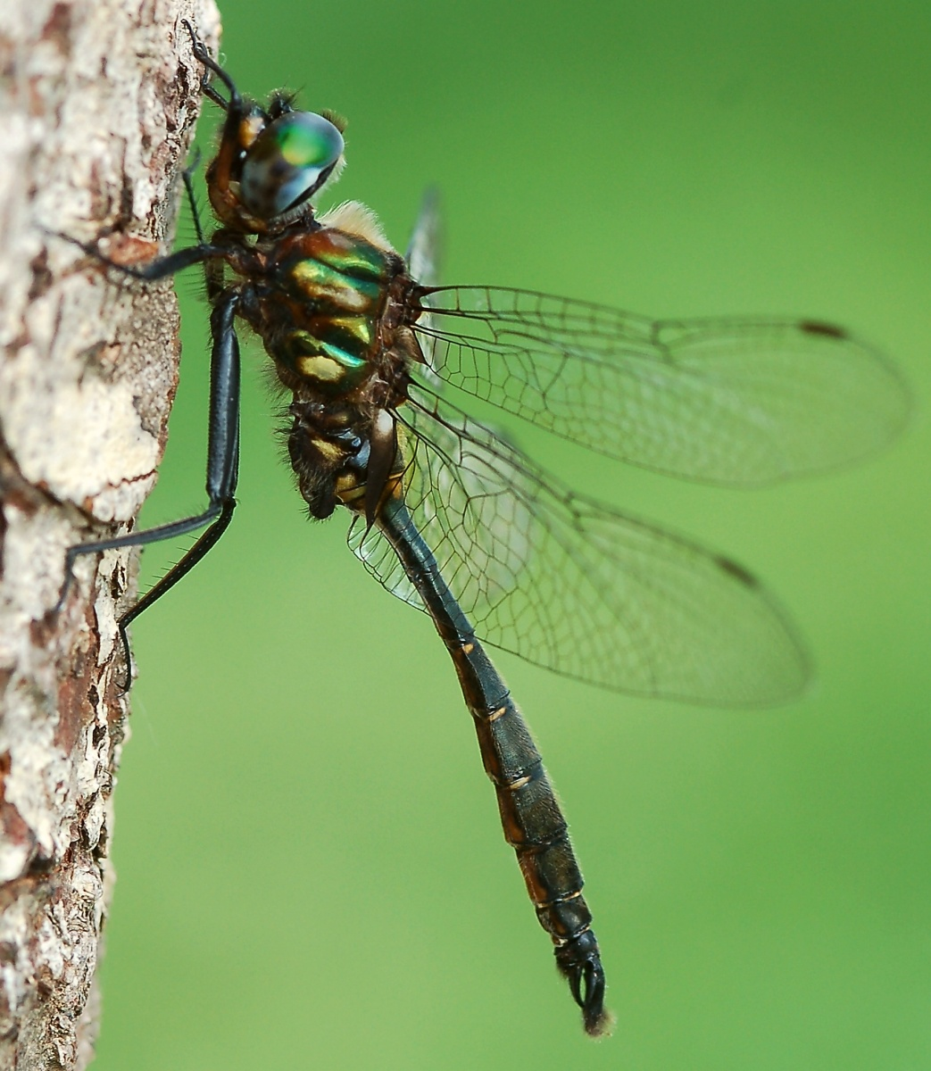
Clamp-tipped Emerald (left) and Brush-tipped Emerald

Slide 42
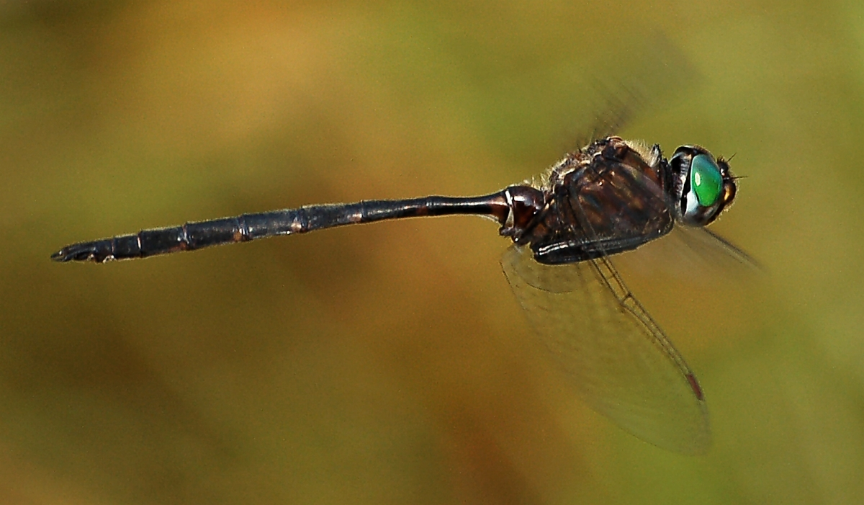
Incurvate Emerald in flight

Slide 43
Skimmers

Slide 45
Chalk-fronted Corporal

Slide 46
Common Whitetail (female laying eggs)

Slide 48
A male « mate-guarding » a female…

Slide 50
A Crimson-ringed Whiteface

Slide 51
White-faced Meadowhawk

Slide 52
Band-winged Meadowhawk

Slide 53
Autumn Meadowhawk

Slide 54
Wandering Glider

Slide 55
The End...
Questions?

